Slide 1

Vanderbilt University Medical Center
Elective Surgery Schedule
Indu 6611 Case Study 2

Slide 2

Table of Contents
WHO?
Word Cloud
Prediction Capabilities
Data Collected
Analyzing Data
Removing Outliers
Preprocessing Data
Modeling Data
Best Model
Best Lookahead Window
The Next Steps for Vanderbilt
Addendum

Slide 3
Who?
Ajay Bose Surgical Business Analytics requires consultation to better predict Surgery Demands
Their scheduling process incurs a 6% urgent priority scheduling that causes unexpected costs, and inefficiency due to schedule deviation.
The finance department is capable of budgeting with high accuracy on a monthly basis, but when it comes to daily predictions accuracy is quite low.
Ajay wants solutions to better improve surgical and ancillary scheduling.
Notes:
Background Problem Statement (or Statement of main question(s) to be answered) Quantitative Approach Approach (Model/Analysis/Results) Statement of Necessary Assumptions (could go before or after the description of the approach itself) Recommendations (what do you recommend to the organization/decision-maker of the case based on your analysis; your recommendations should be as concrete as possible and should be supported by your analysis)

Slide 4
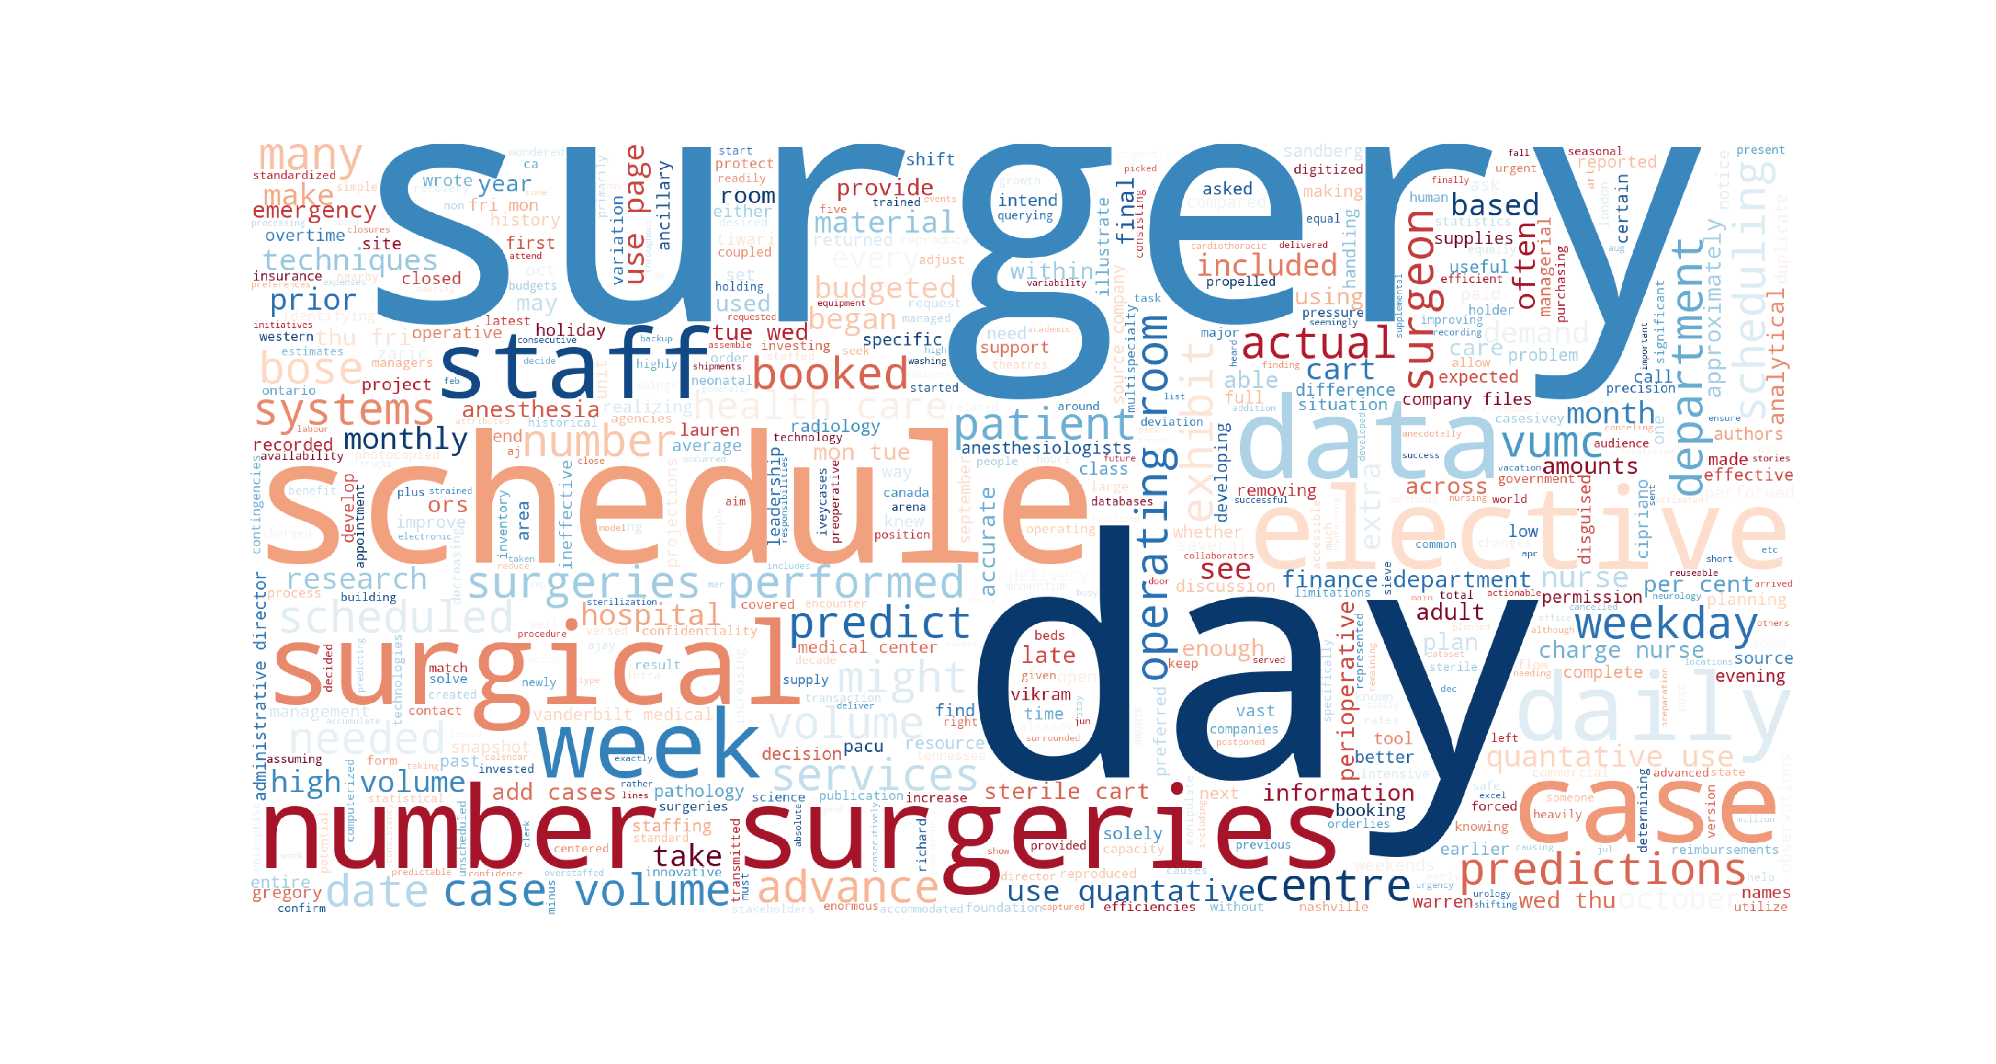

Slide 5
Prediction Capabilities
An obvious approach Ajay should attempt to take would be utilizing Machine learning or Time Series to try and predict daily surgical demand/needs.
Linear Regression
Least Squares
ARIMA
SARIMA
LSTM
The data collected will be analyzed, and number of days prior should be tested against the models.

Slide 6
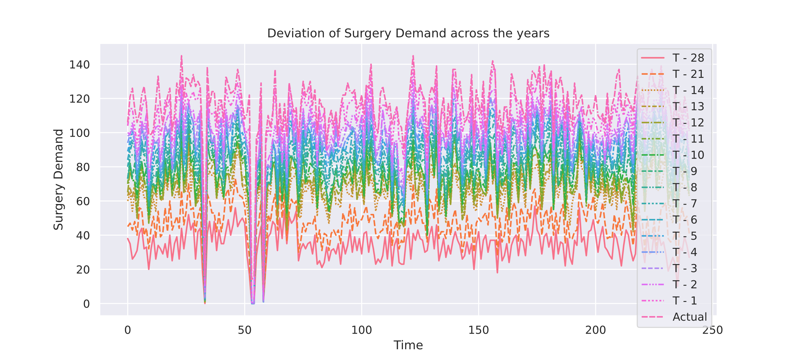
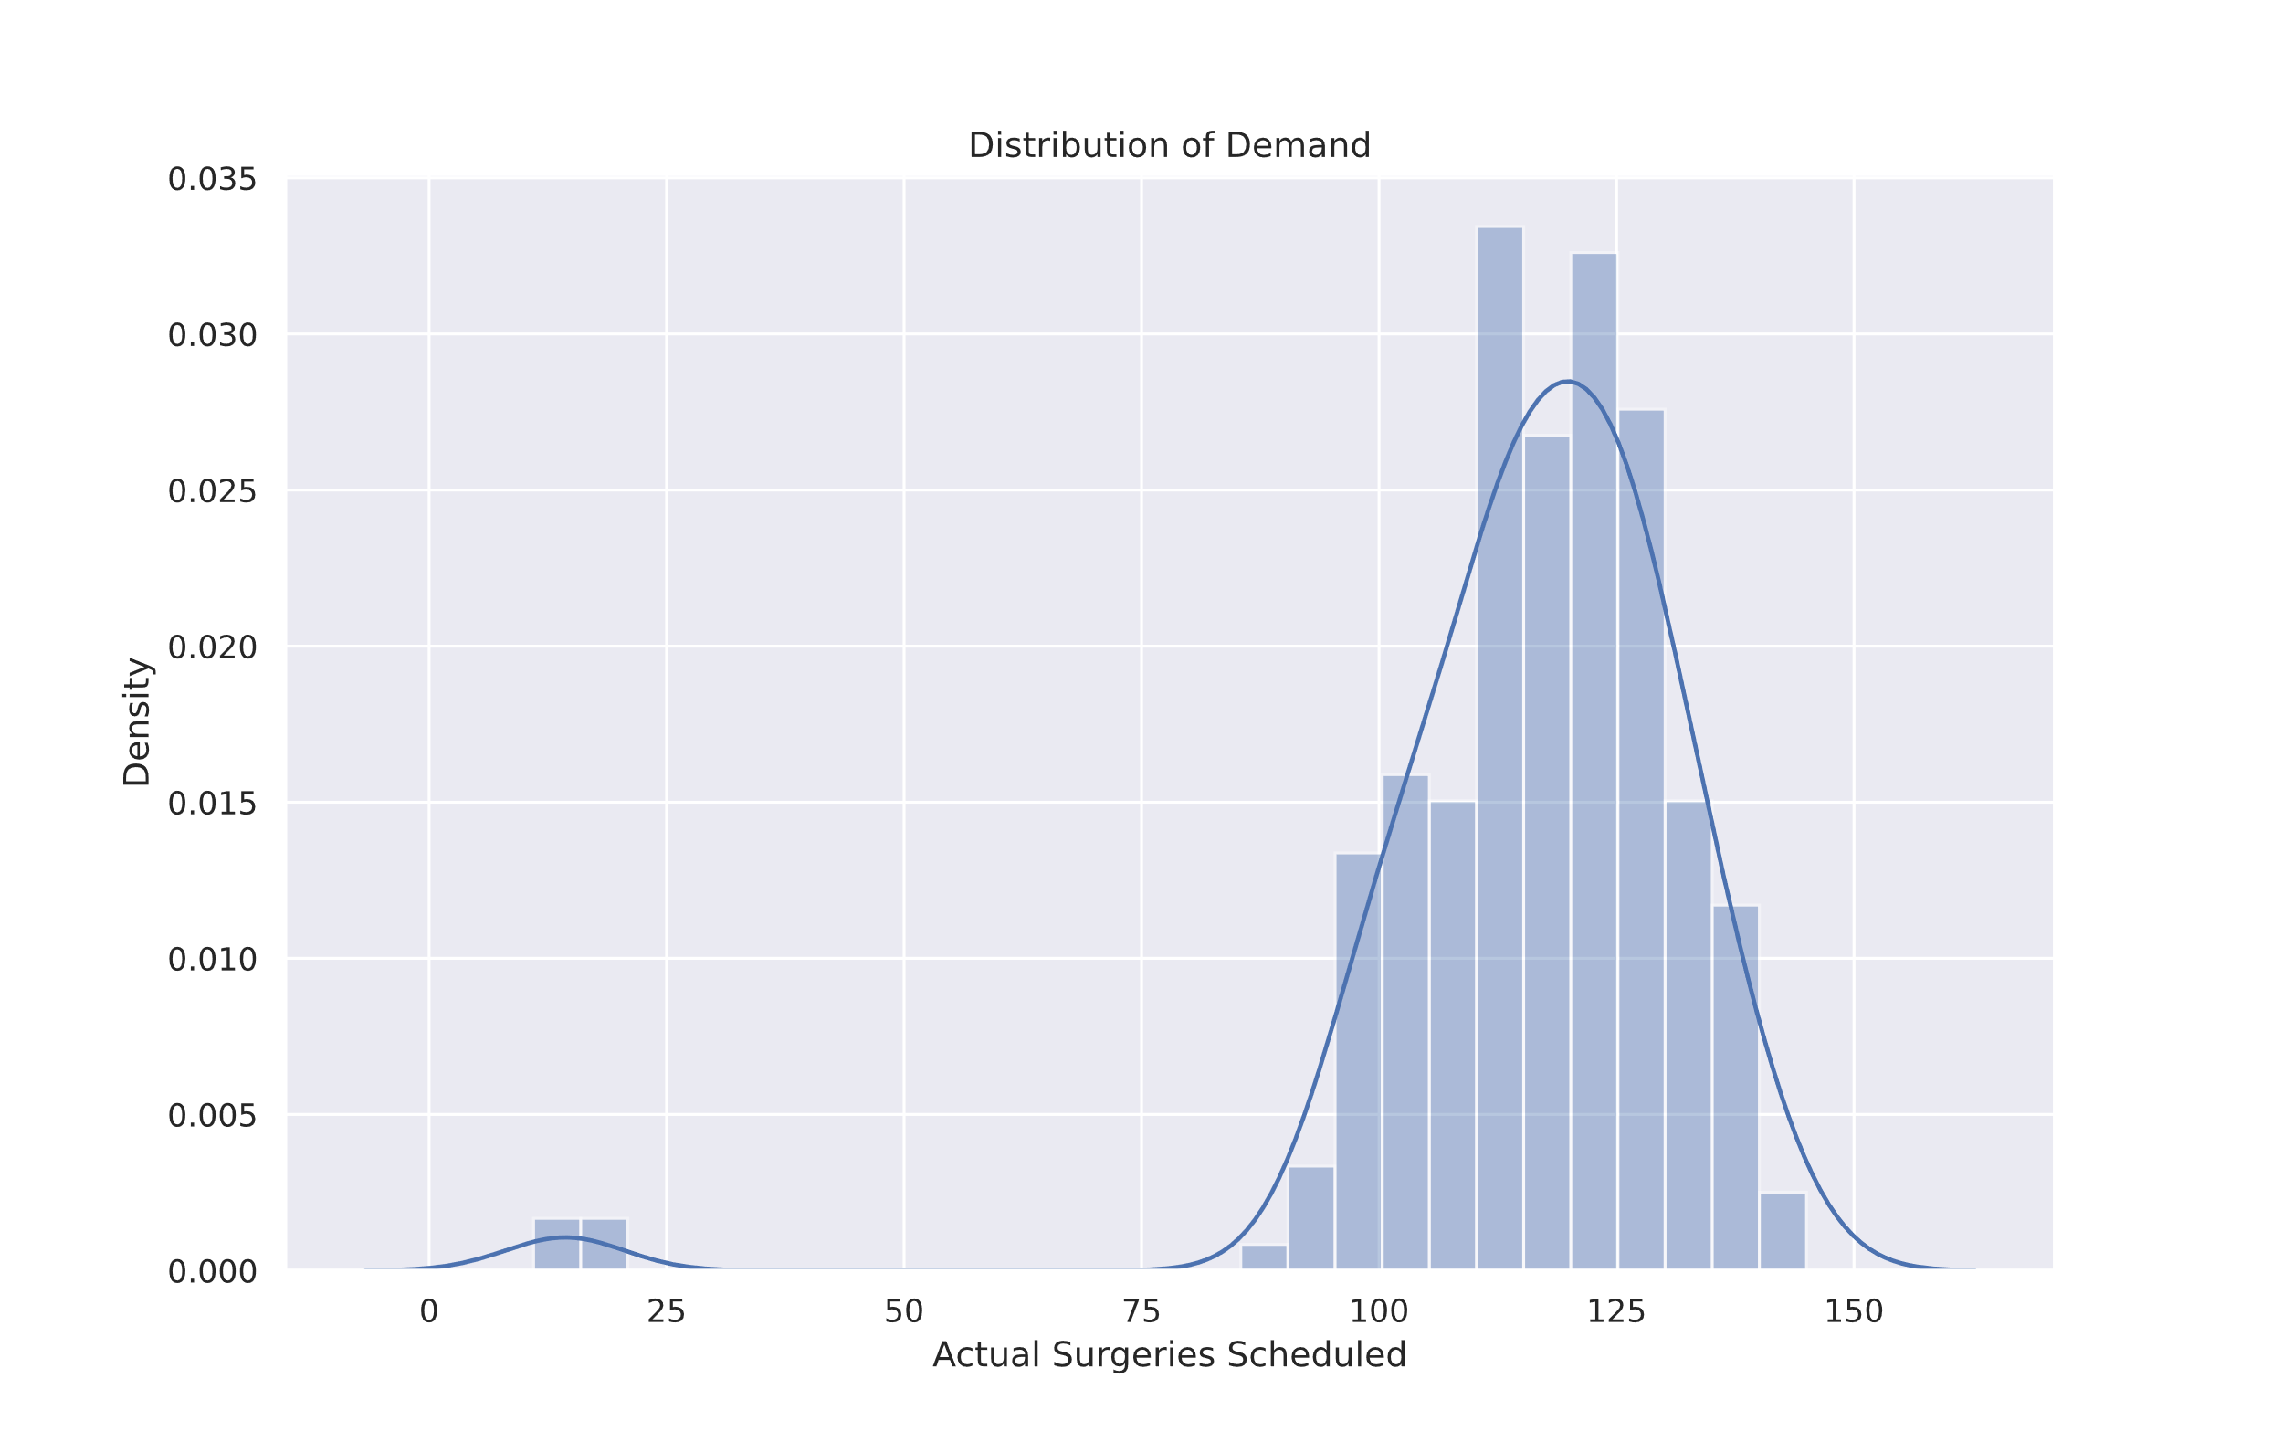
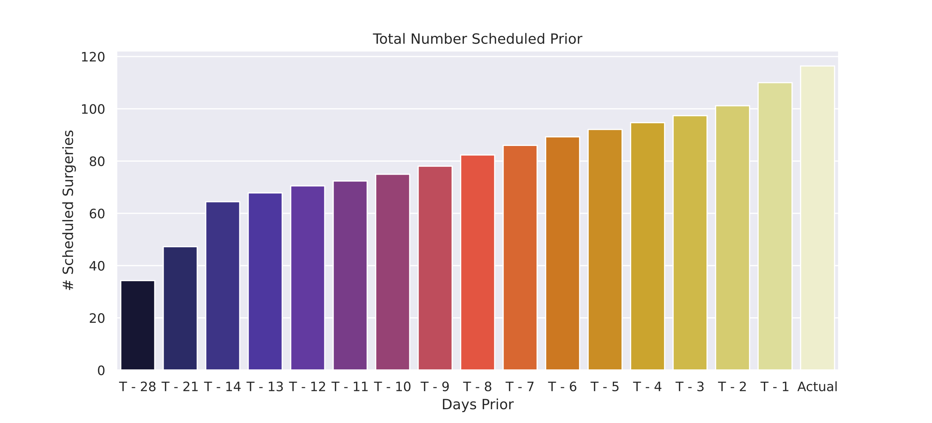
Data collected
Variation of data occurs in days prior as well.
Some outliers exist
The data could be perceived as normally distributed
Notes:
Taking a quick Look at the data, we see that the demand variation follow a similar pattern, even for data collected in T-28. Also we see some outliers exists, below 25

Slide 7
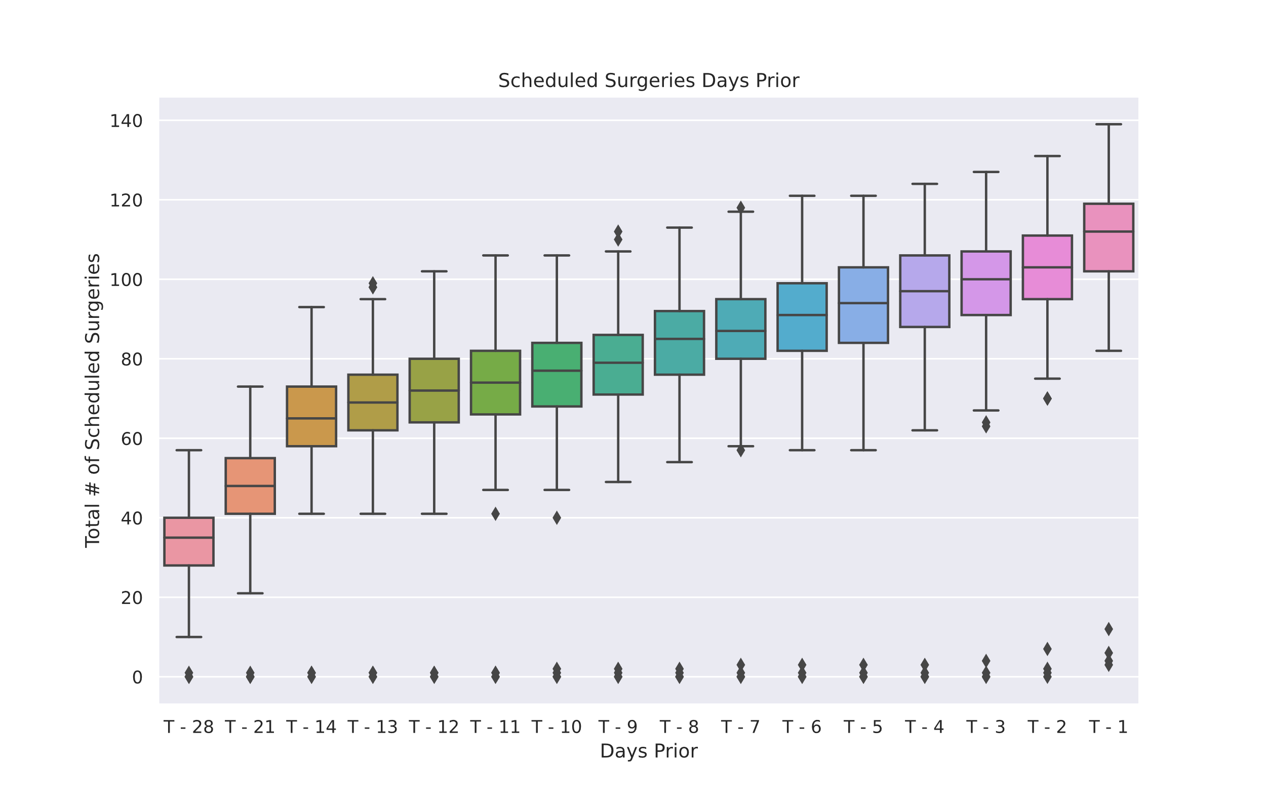
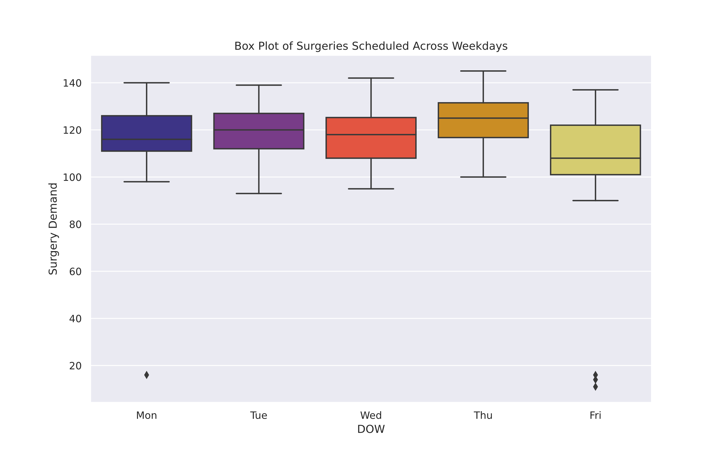
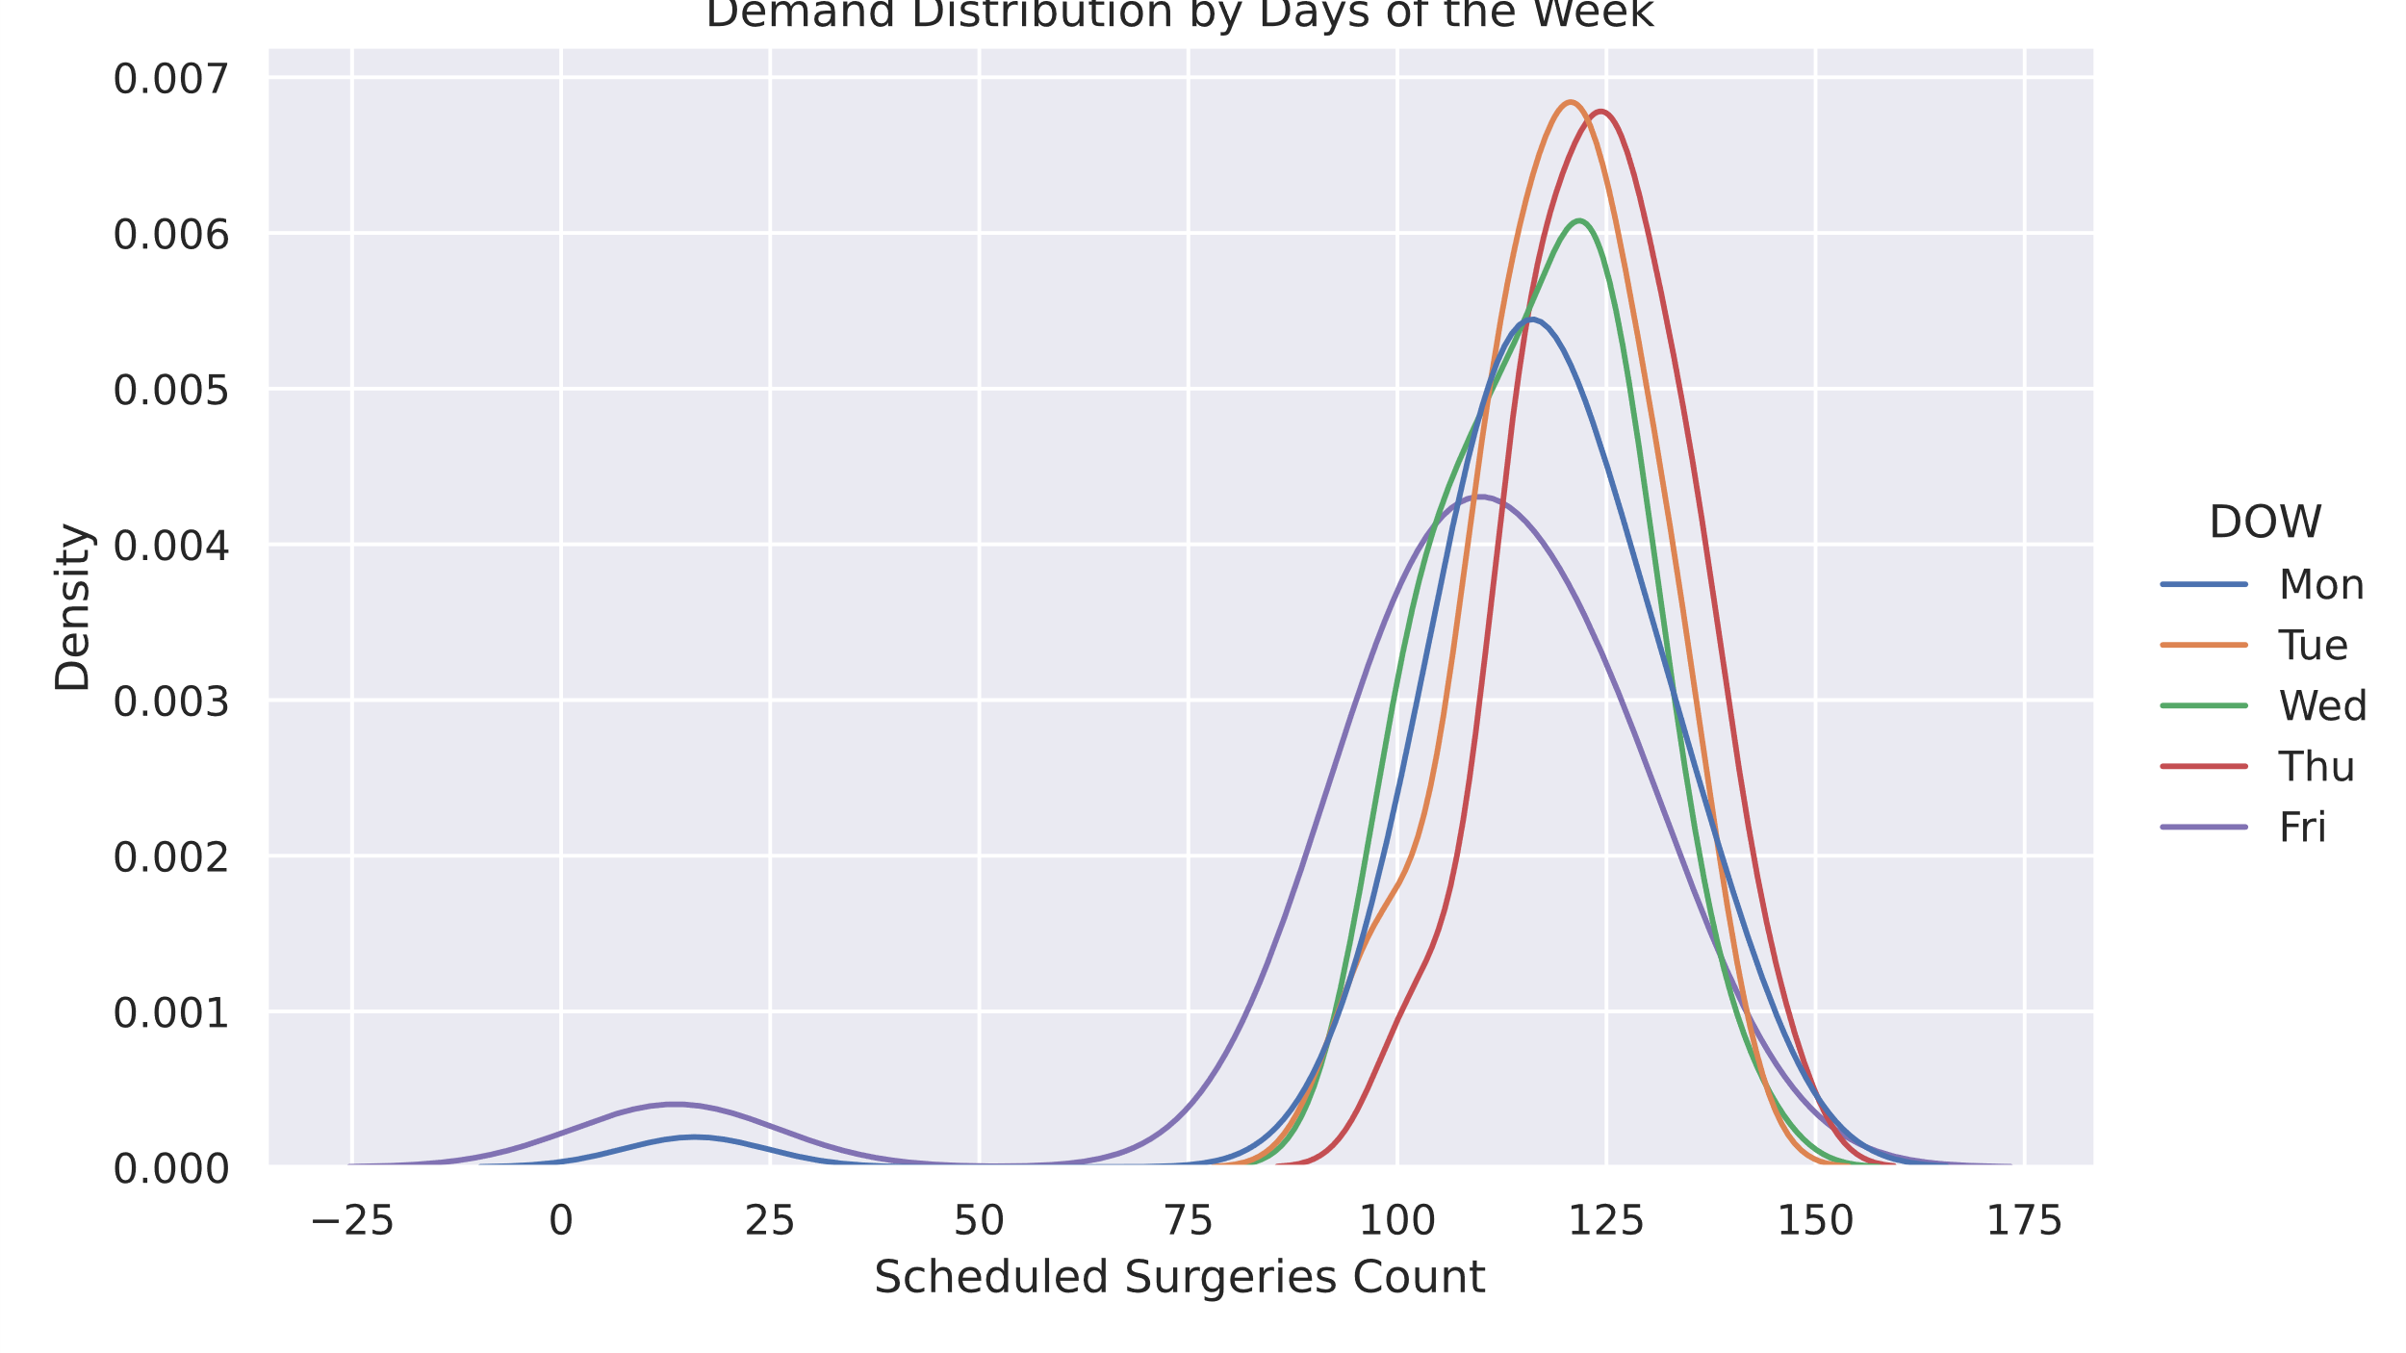
Analyzing Data
The outliers exist mostly on Monday, and Friday
T-1 have less than 20 surgeries sometimes
Tuesdays and Thursdays have the highest probability of having the most surgeries
Thursdays have the highest surgeries performed (probably out of urgency)

Slide 8
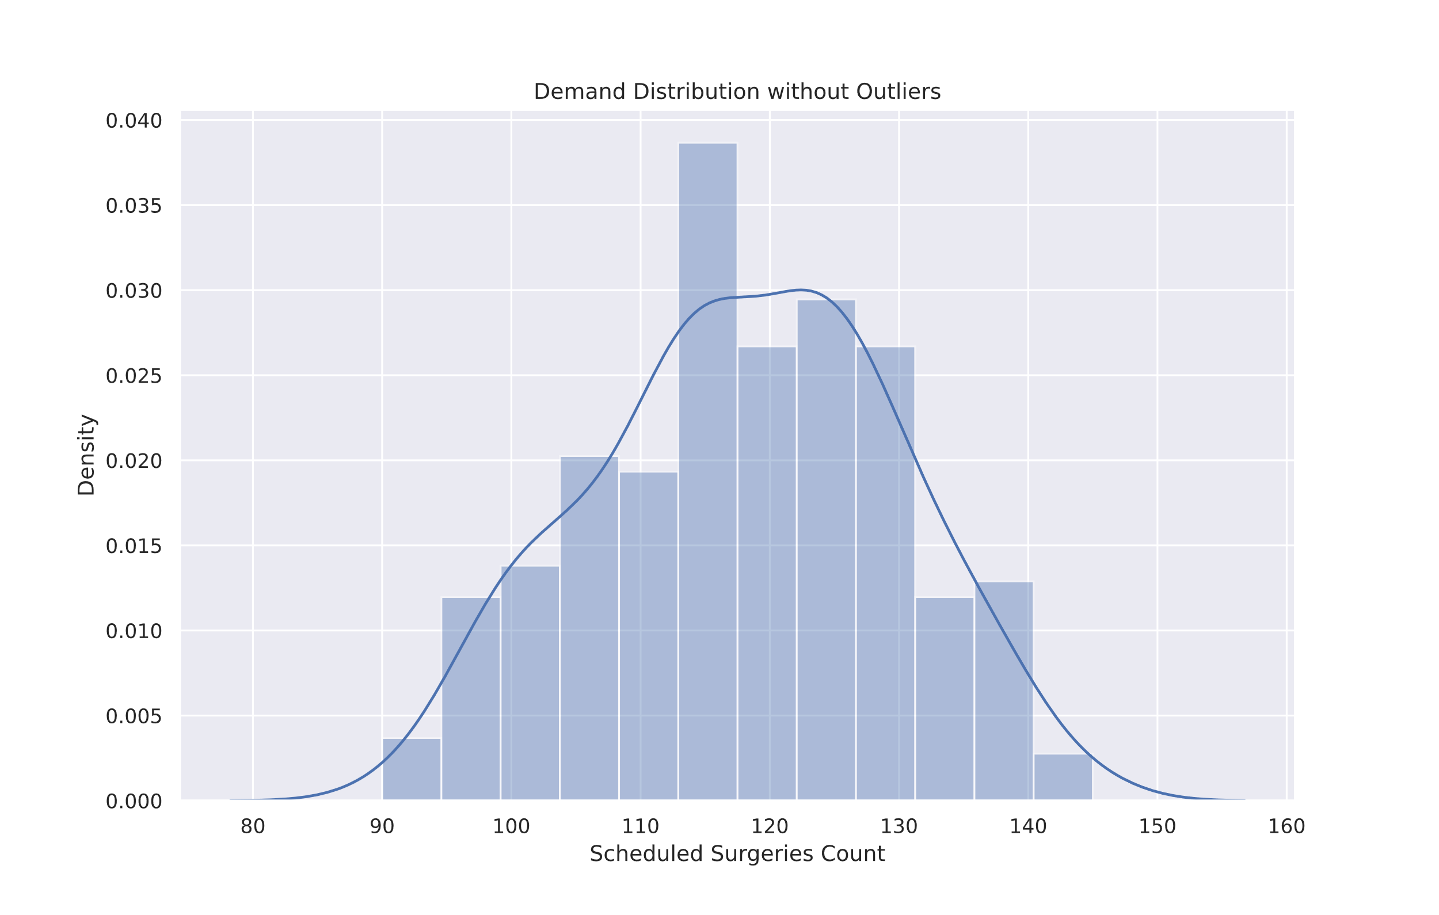
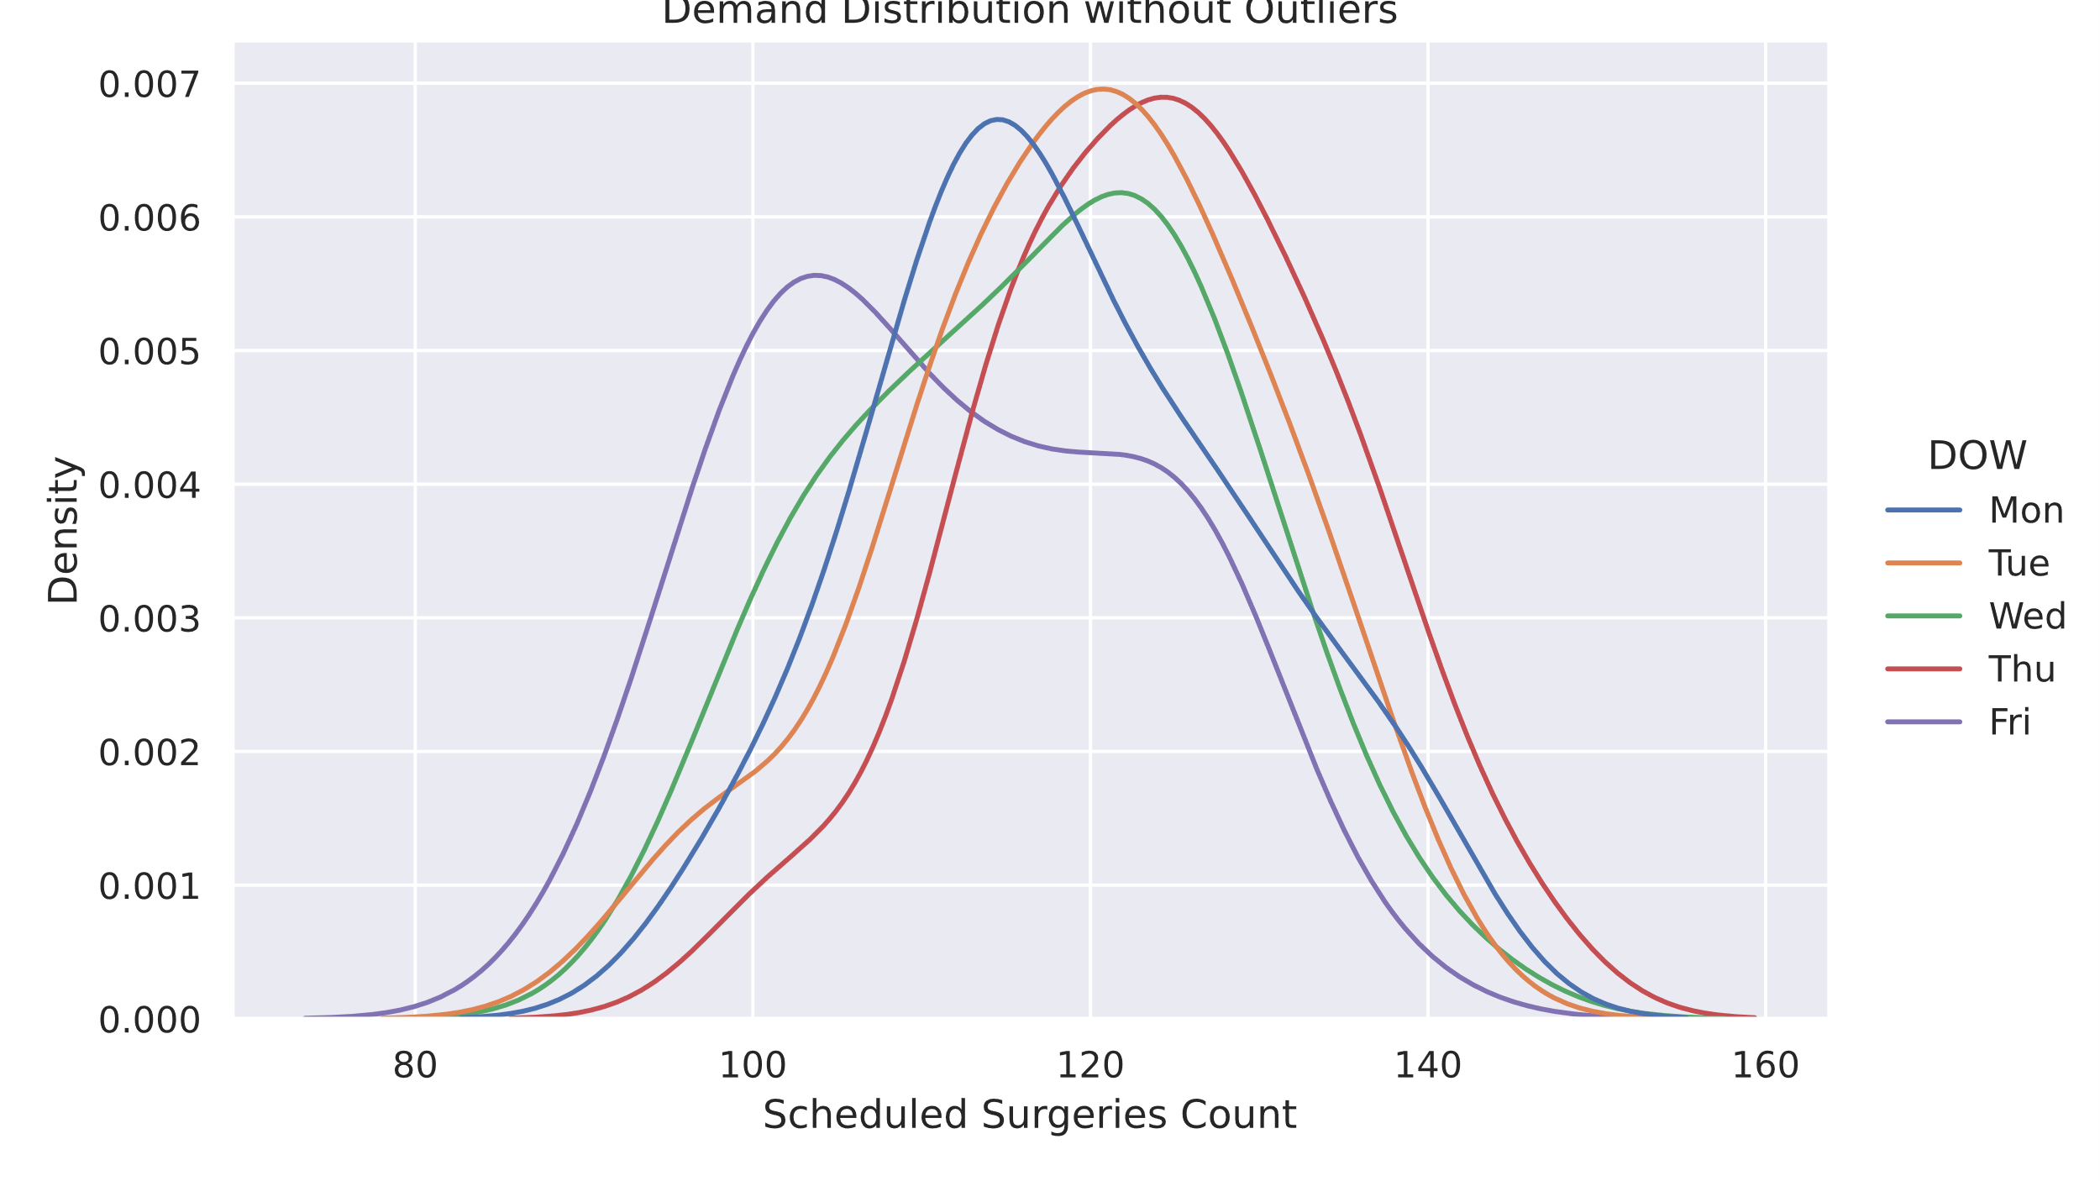
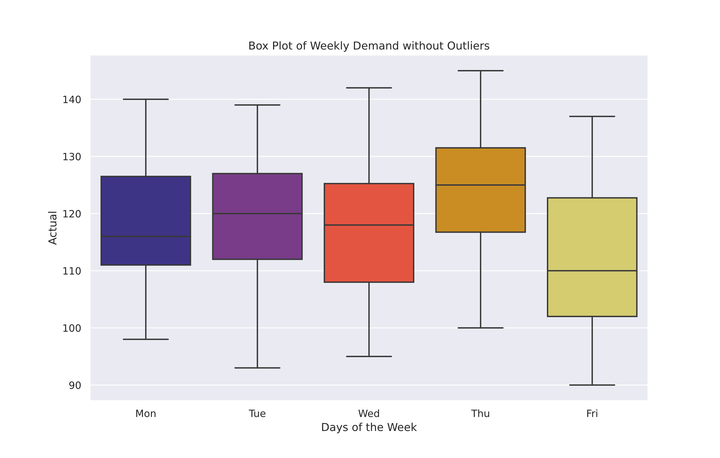
Removing outliers
Removing the outliers, we resemble more and more a normal distribution, except for Monday, Wednesday, and Friday, that seem to encounter higher variability.

Slide 9
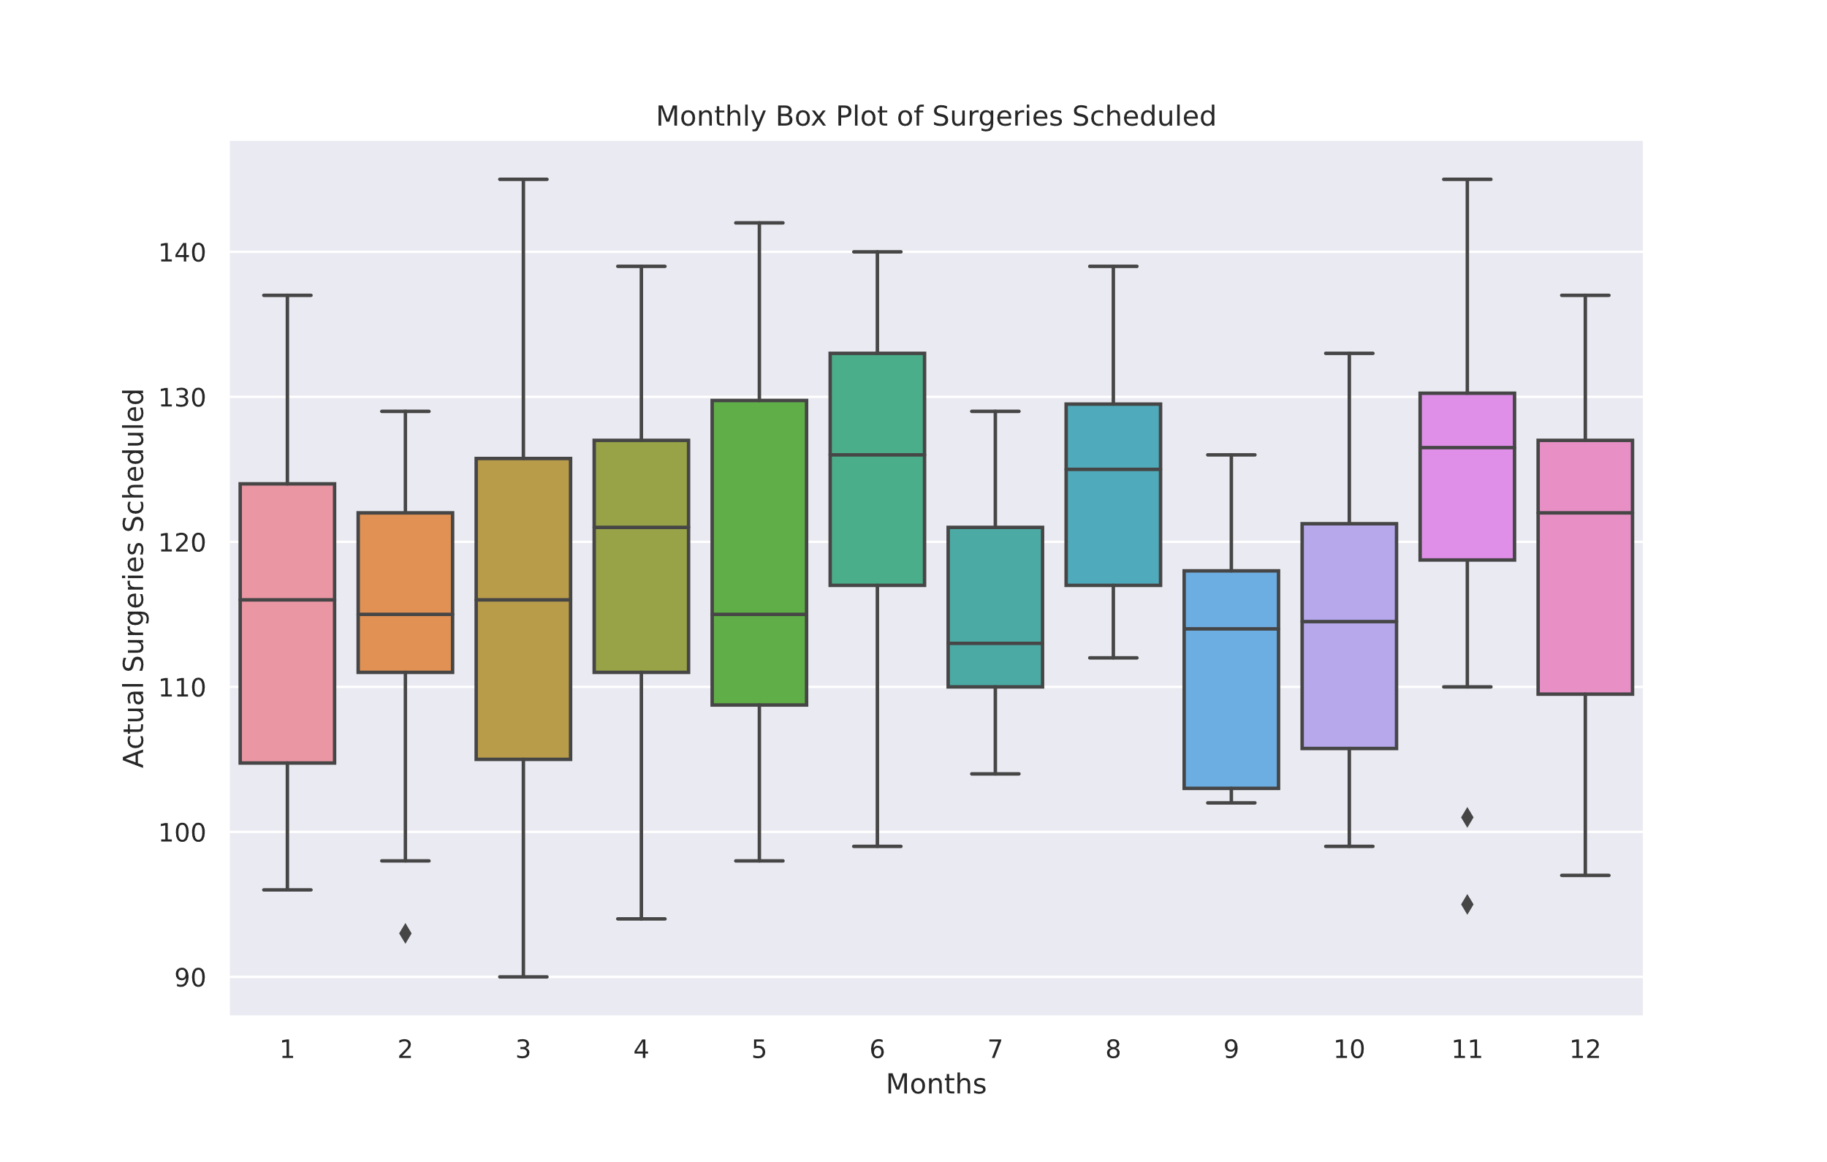
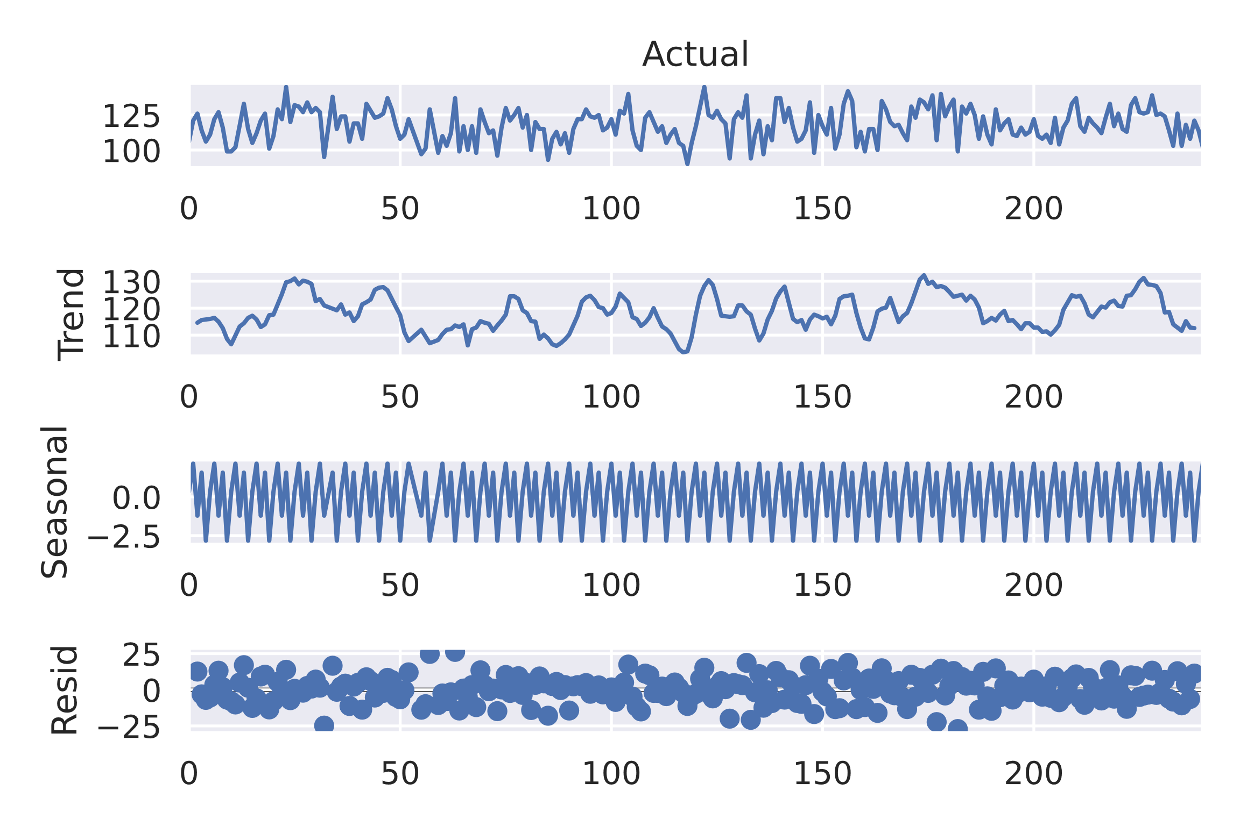
Preprocessing data
A second Dataframe was created to model the days, months, and set a timeseries index.
Yearly Seasonality does not seem to exist in the data,
Weekly Seasonality might, since doctors prefer Tuesday and Thursday

Slide 10
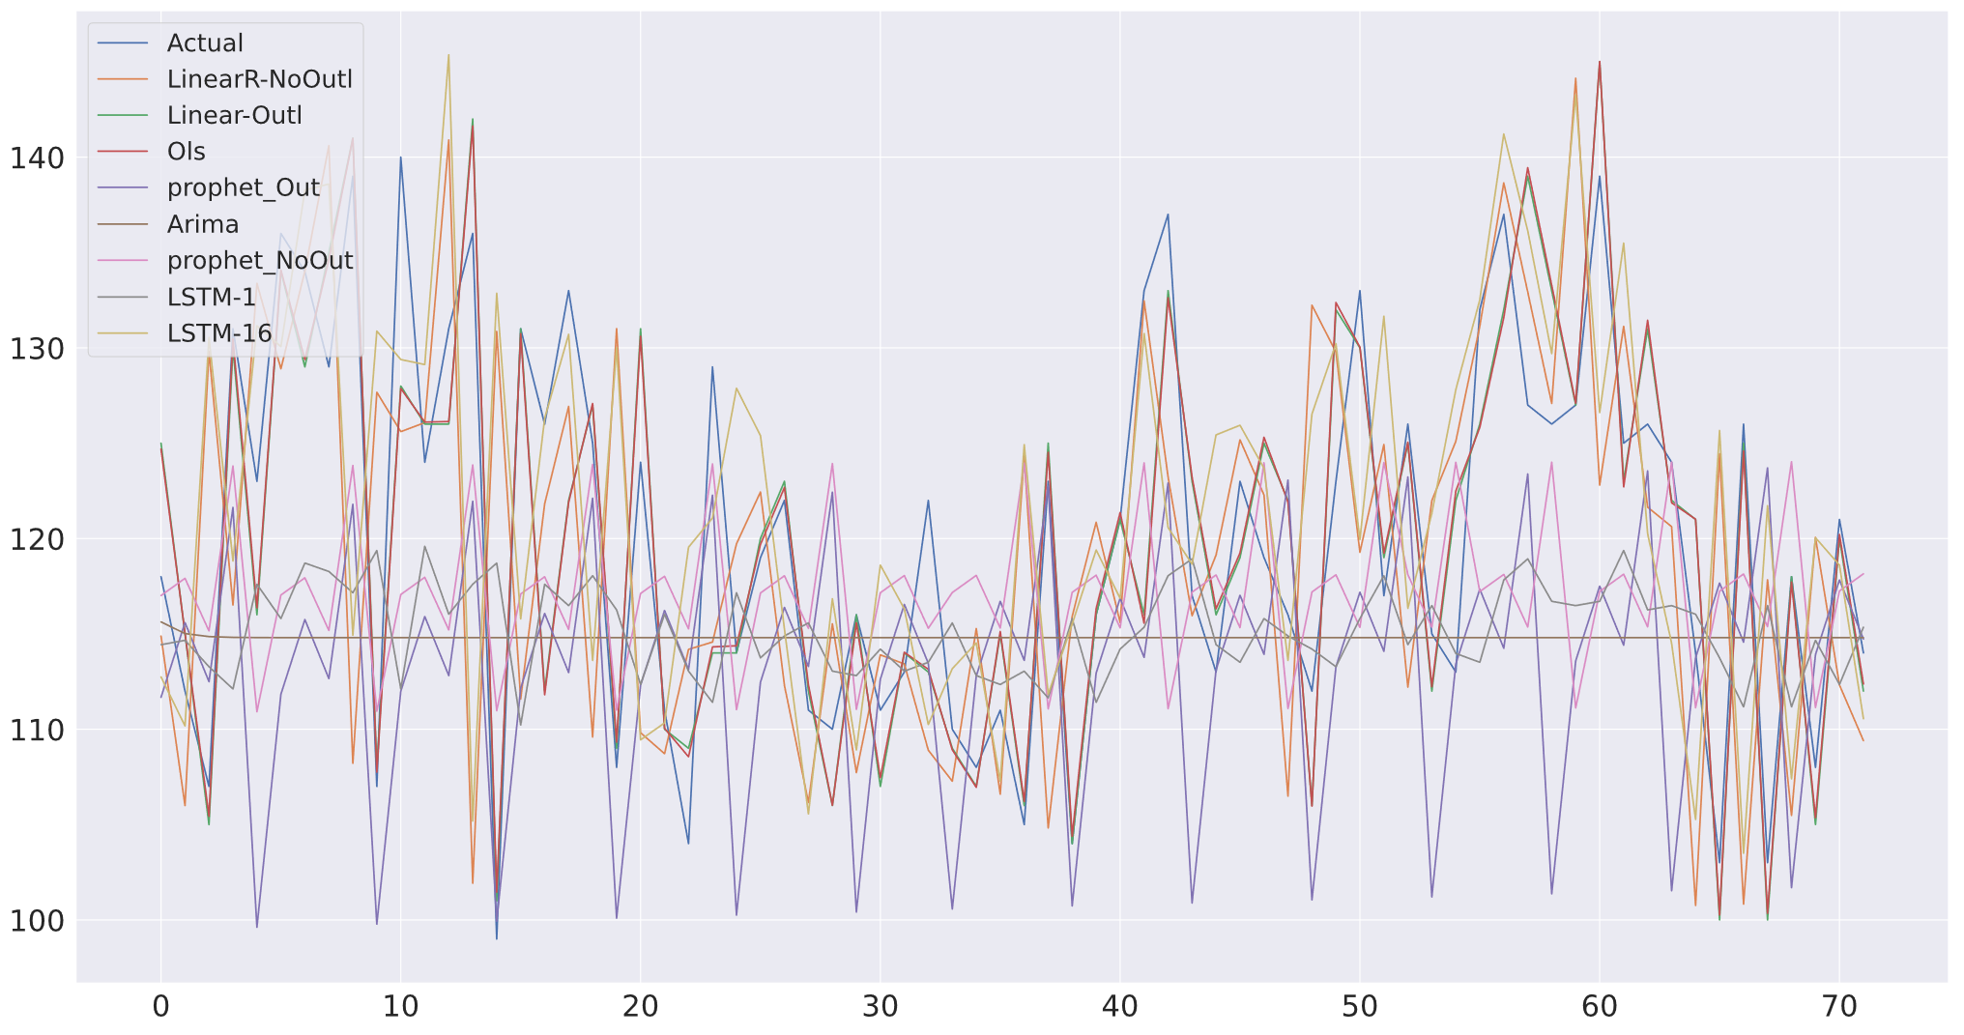
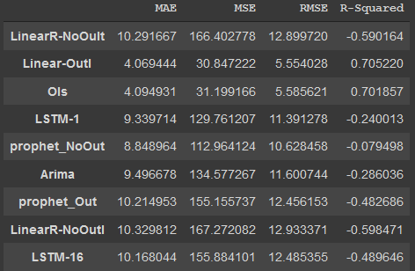
Modeling the data
Several models were utilized on the two different datasets (Outliers, No Outliers) to find out which model performs best on the dataset

Slide 11
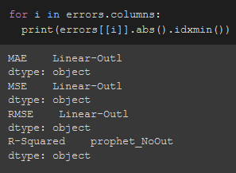
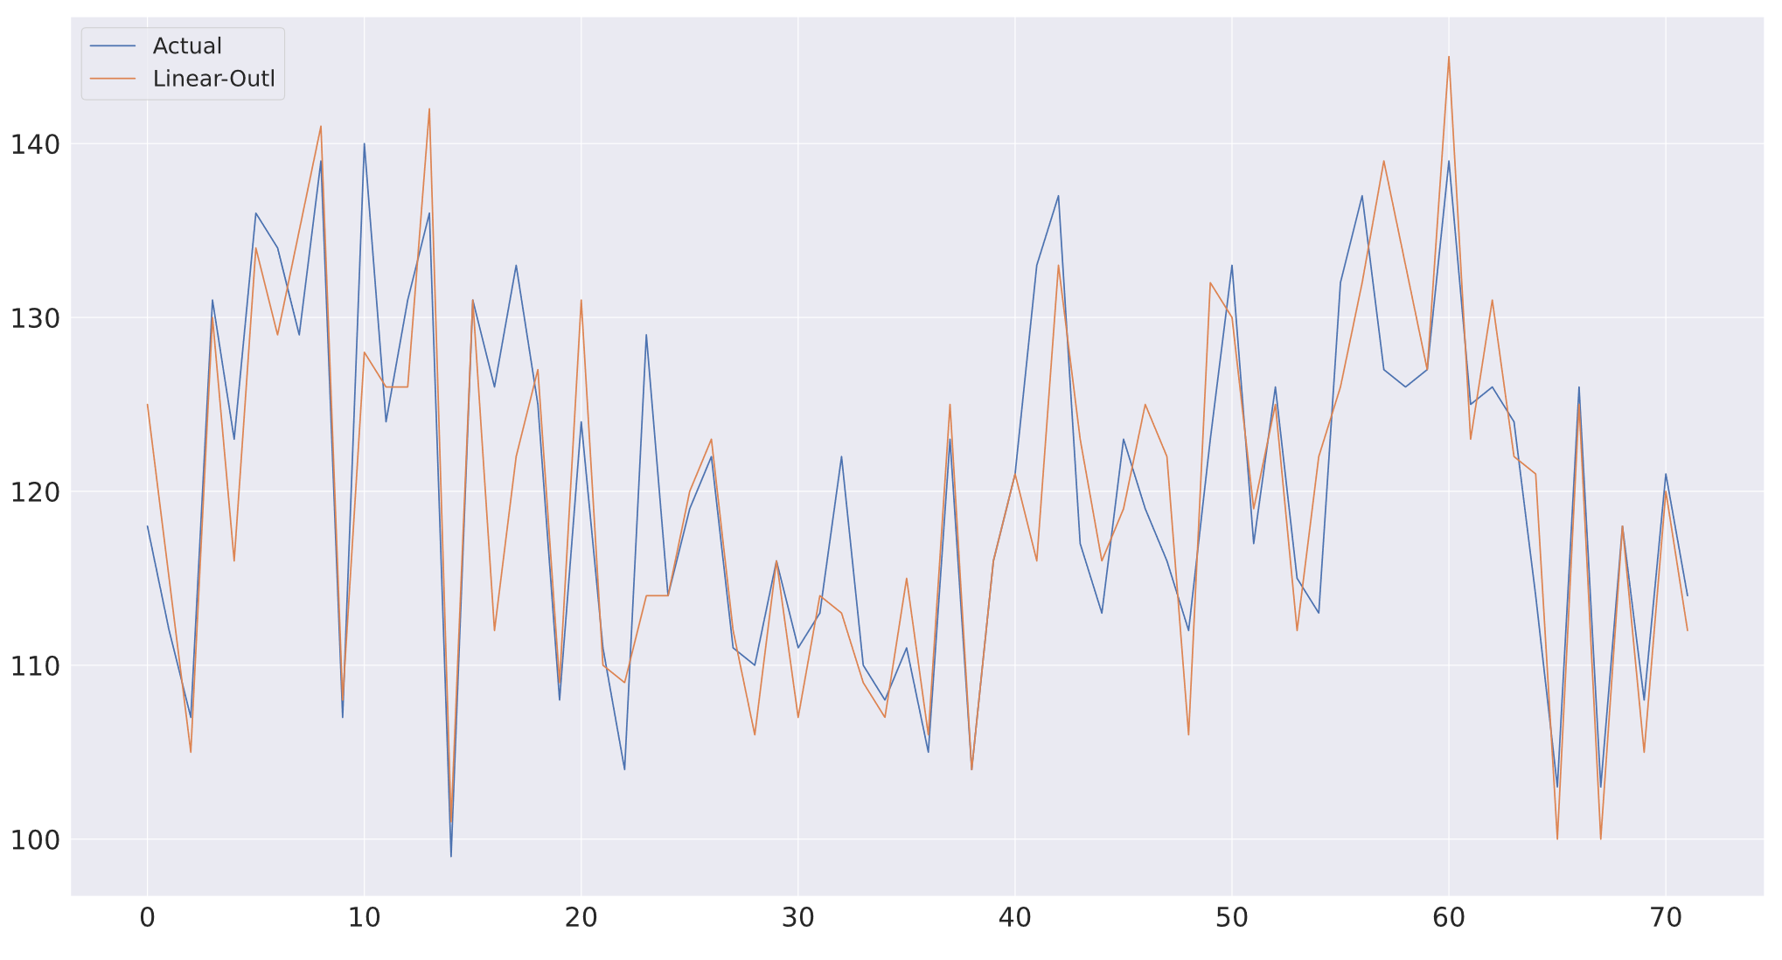
Best model
After extracting the values with the least errors, we conclude that the best model for our data is Linear Regression, including outliers.
Linear model was able to capture the variability in our test data
From here we tested it out with all columns (T-28 – T-1)
Lets see how many days prior we need to get the best model

Slide 12
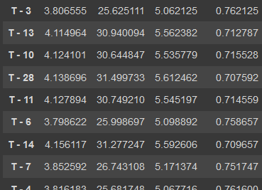
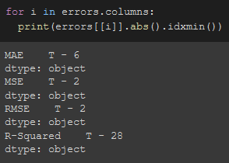
Comparing Models with different look ahead windows
To know the best number of days to start predicting our schedule, we tried all the options by taking in our model T-28 – T-1
After analyzing all the errors for each, we realized that the best model would be Linear Regression with Outliers, with only T – 2

Slide 13
the next steps for vanderbilt
Looking at the models, we have high accuracy to predict daily demand two days prior (on test set)
Start testing it over live data, find more features to add to the data to make it more accurate on live data,
Doctor schedules, notes, or rating of needed schedule
Ambulance response systems
Create an inventory control system (Reordering Point, Safety Stock for anesthetics needed)
Try to connect prediction results with finance department and help each other improve features, and model accuracy

Slide 14

Addendum

Slide 15

Steps to run notebook
Upload csv file with name “7B15E011.csv” & pdf file with name “9B15E011_pcu.pdf”
Run all and watch the magic!

Slide 16
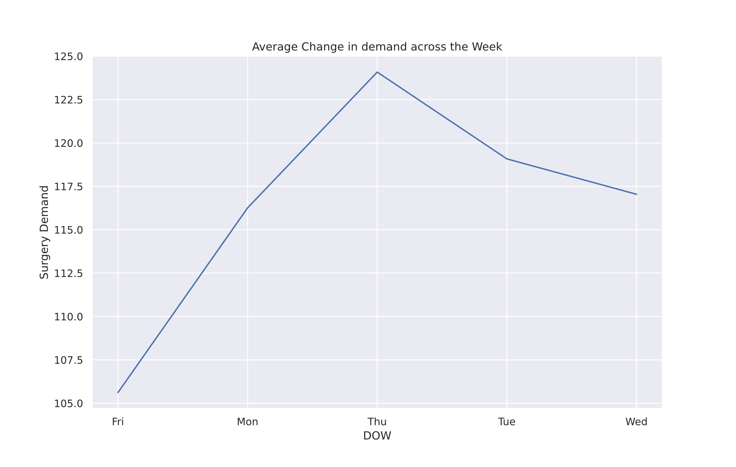
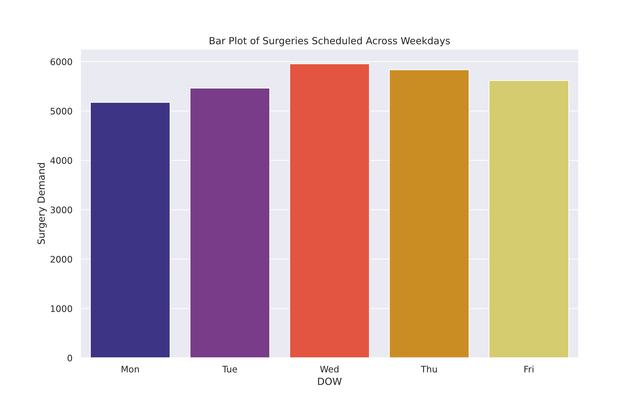
Additional Graphs

Slide 17
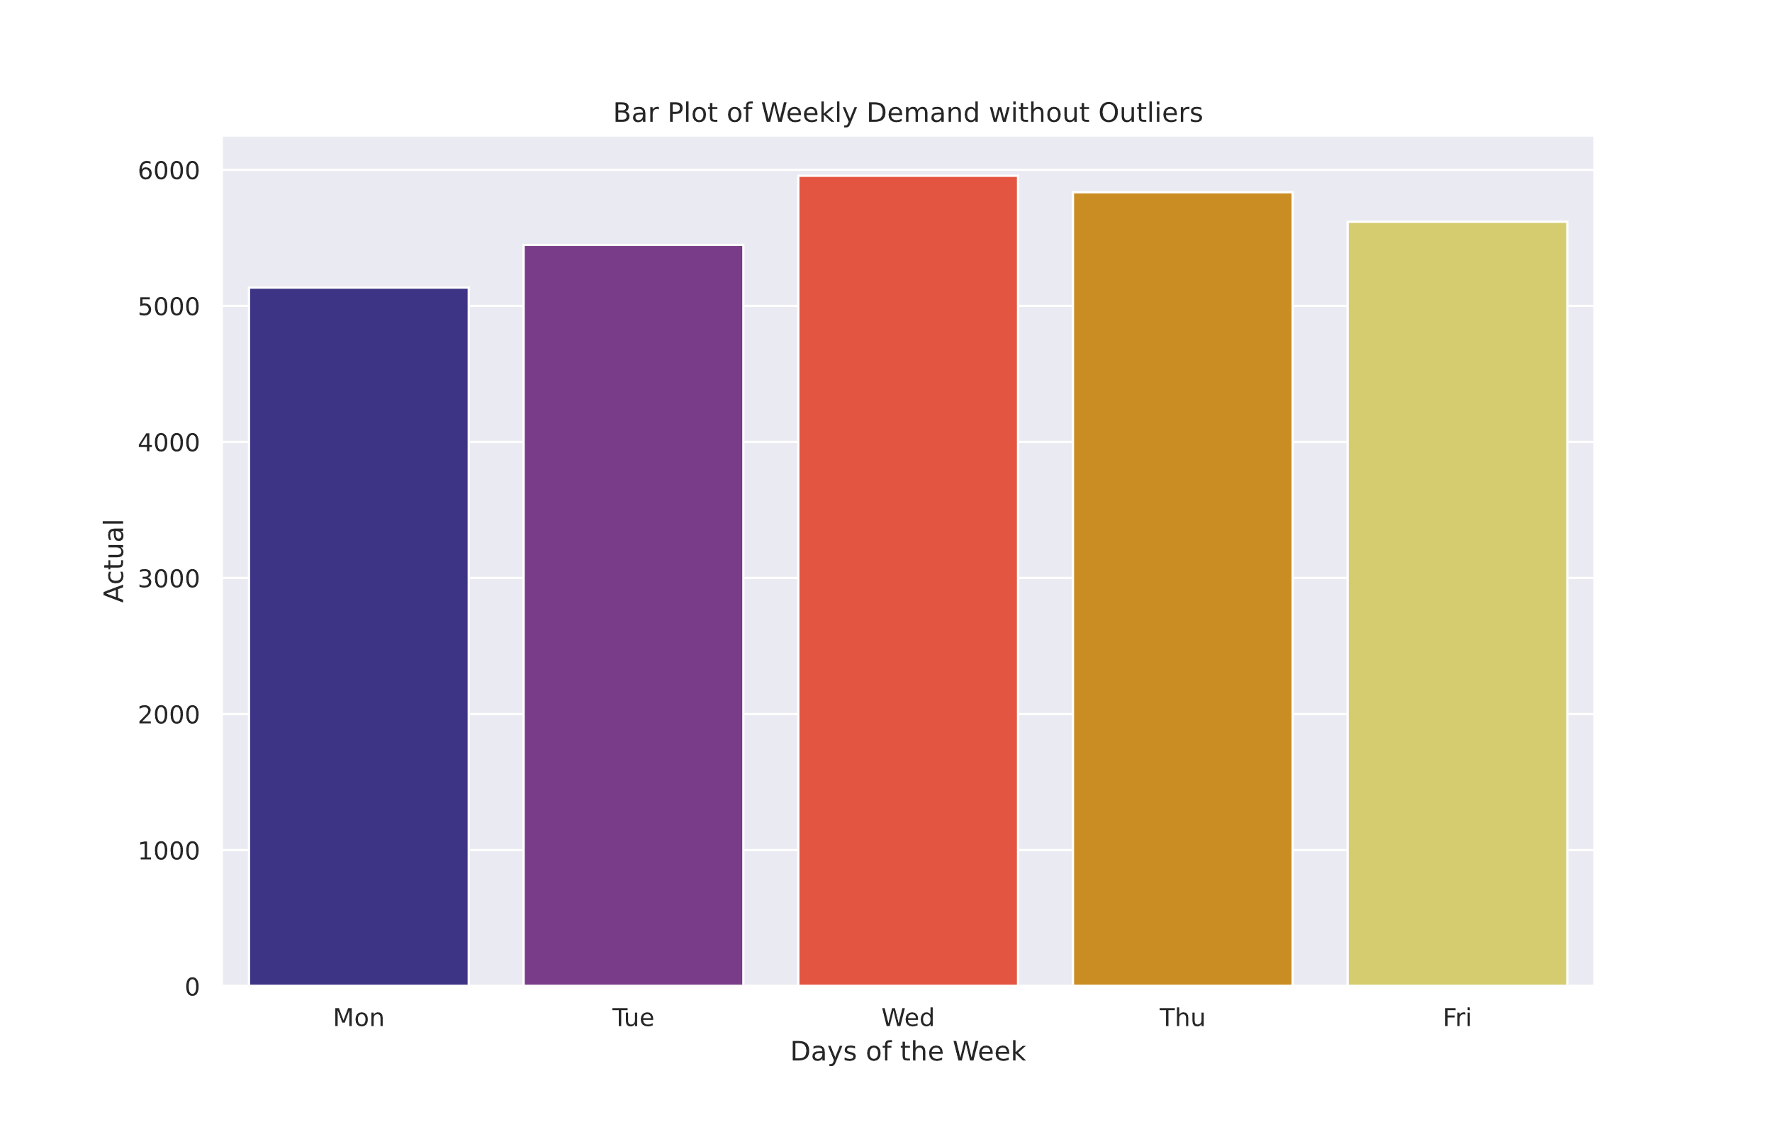
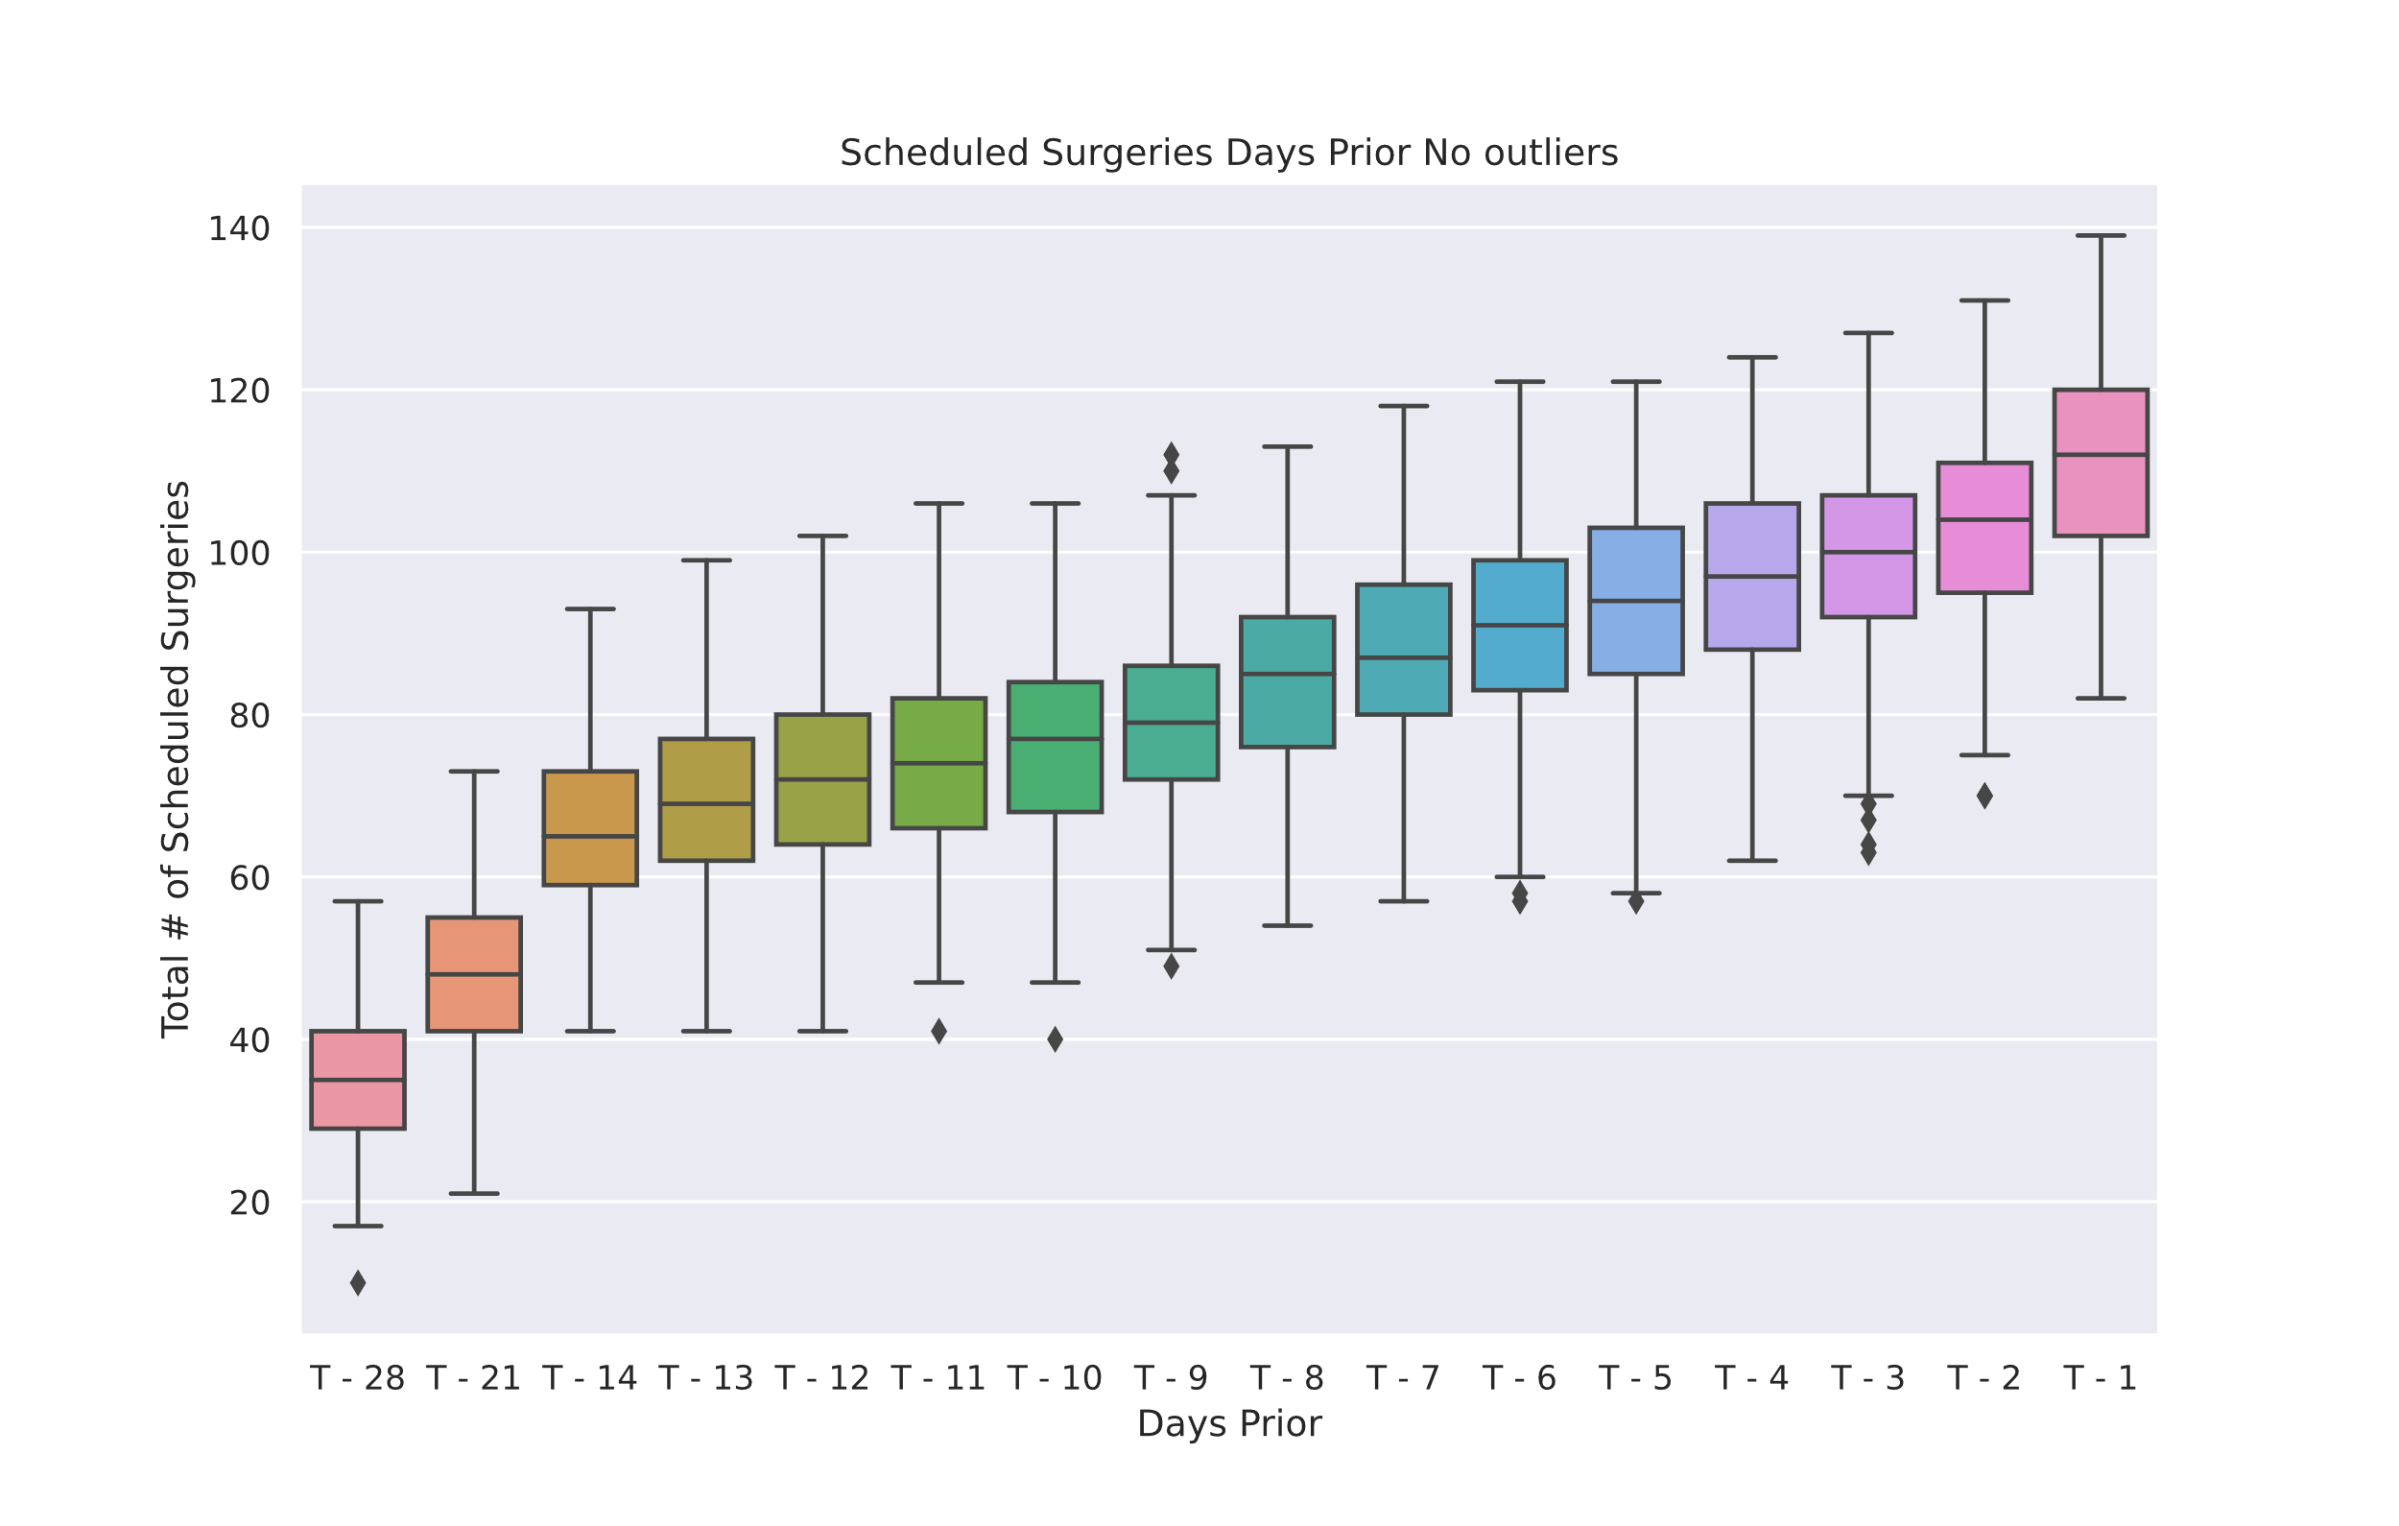
Additional Graphs

Slide 18
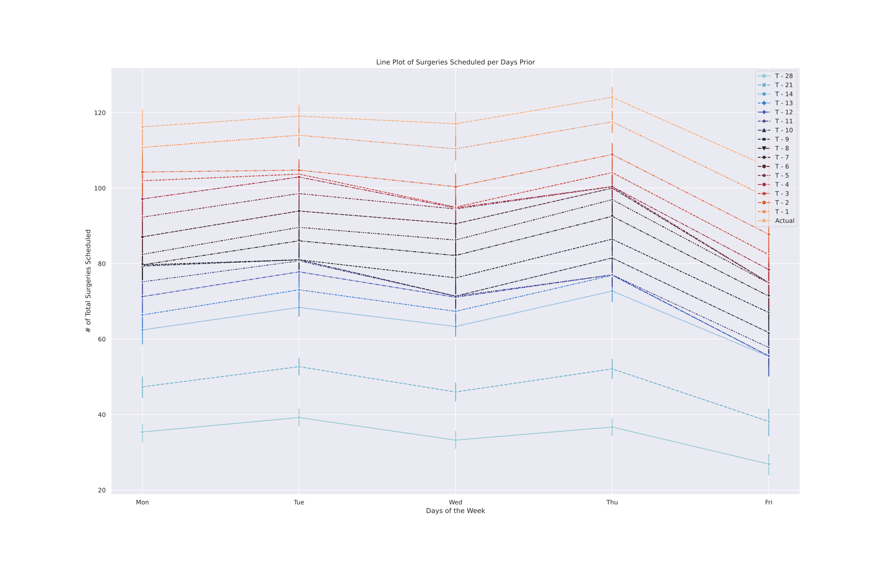
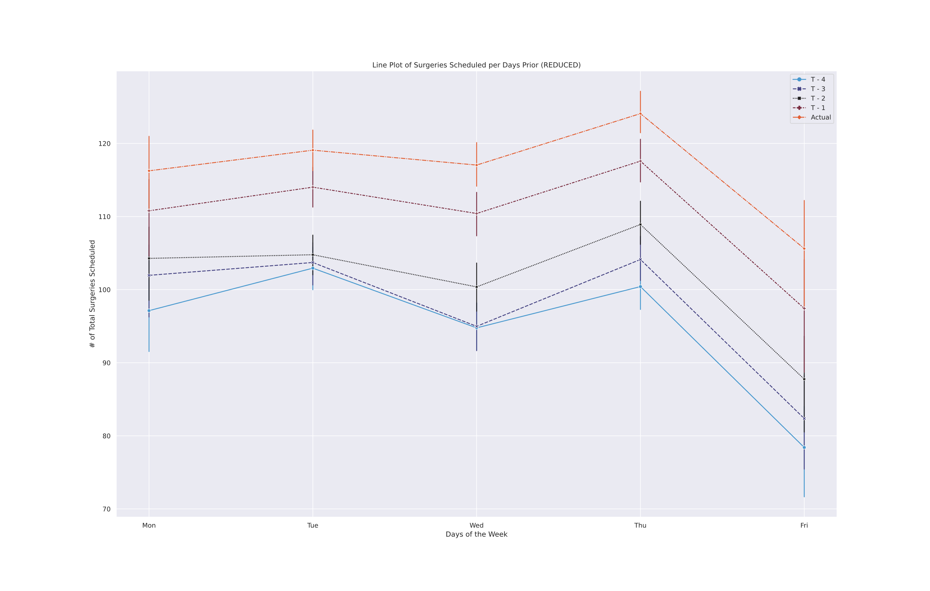
Additional graphs

Slide 19
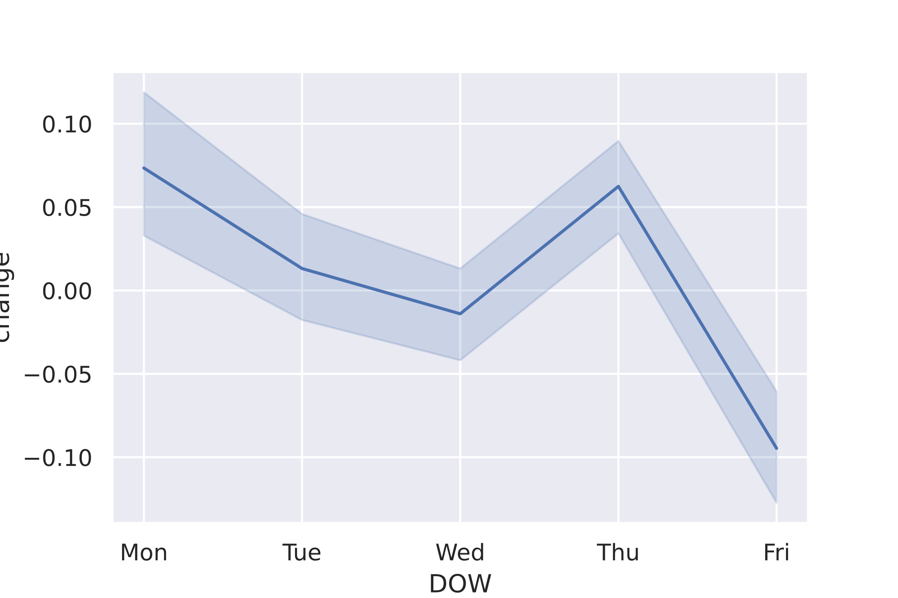
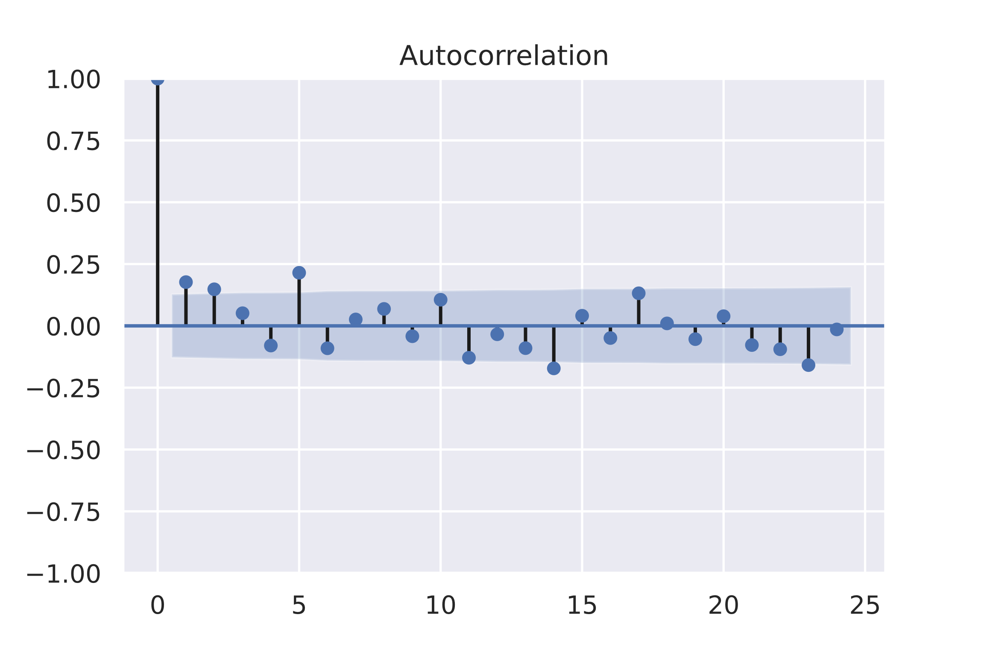
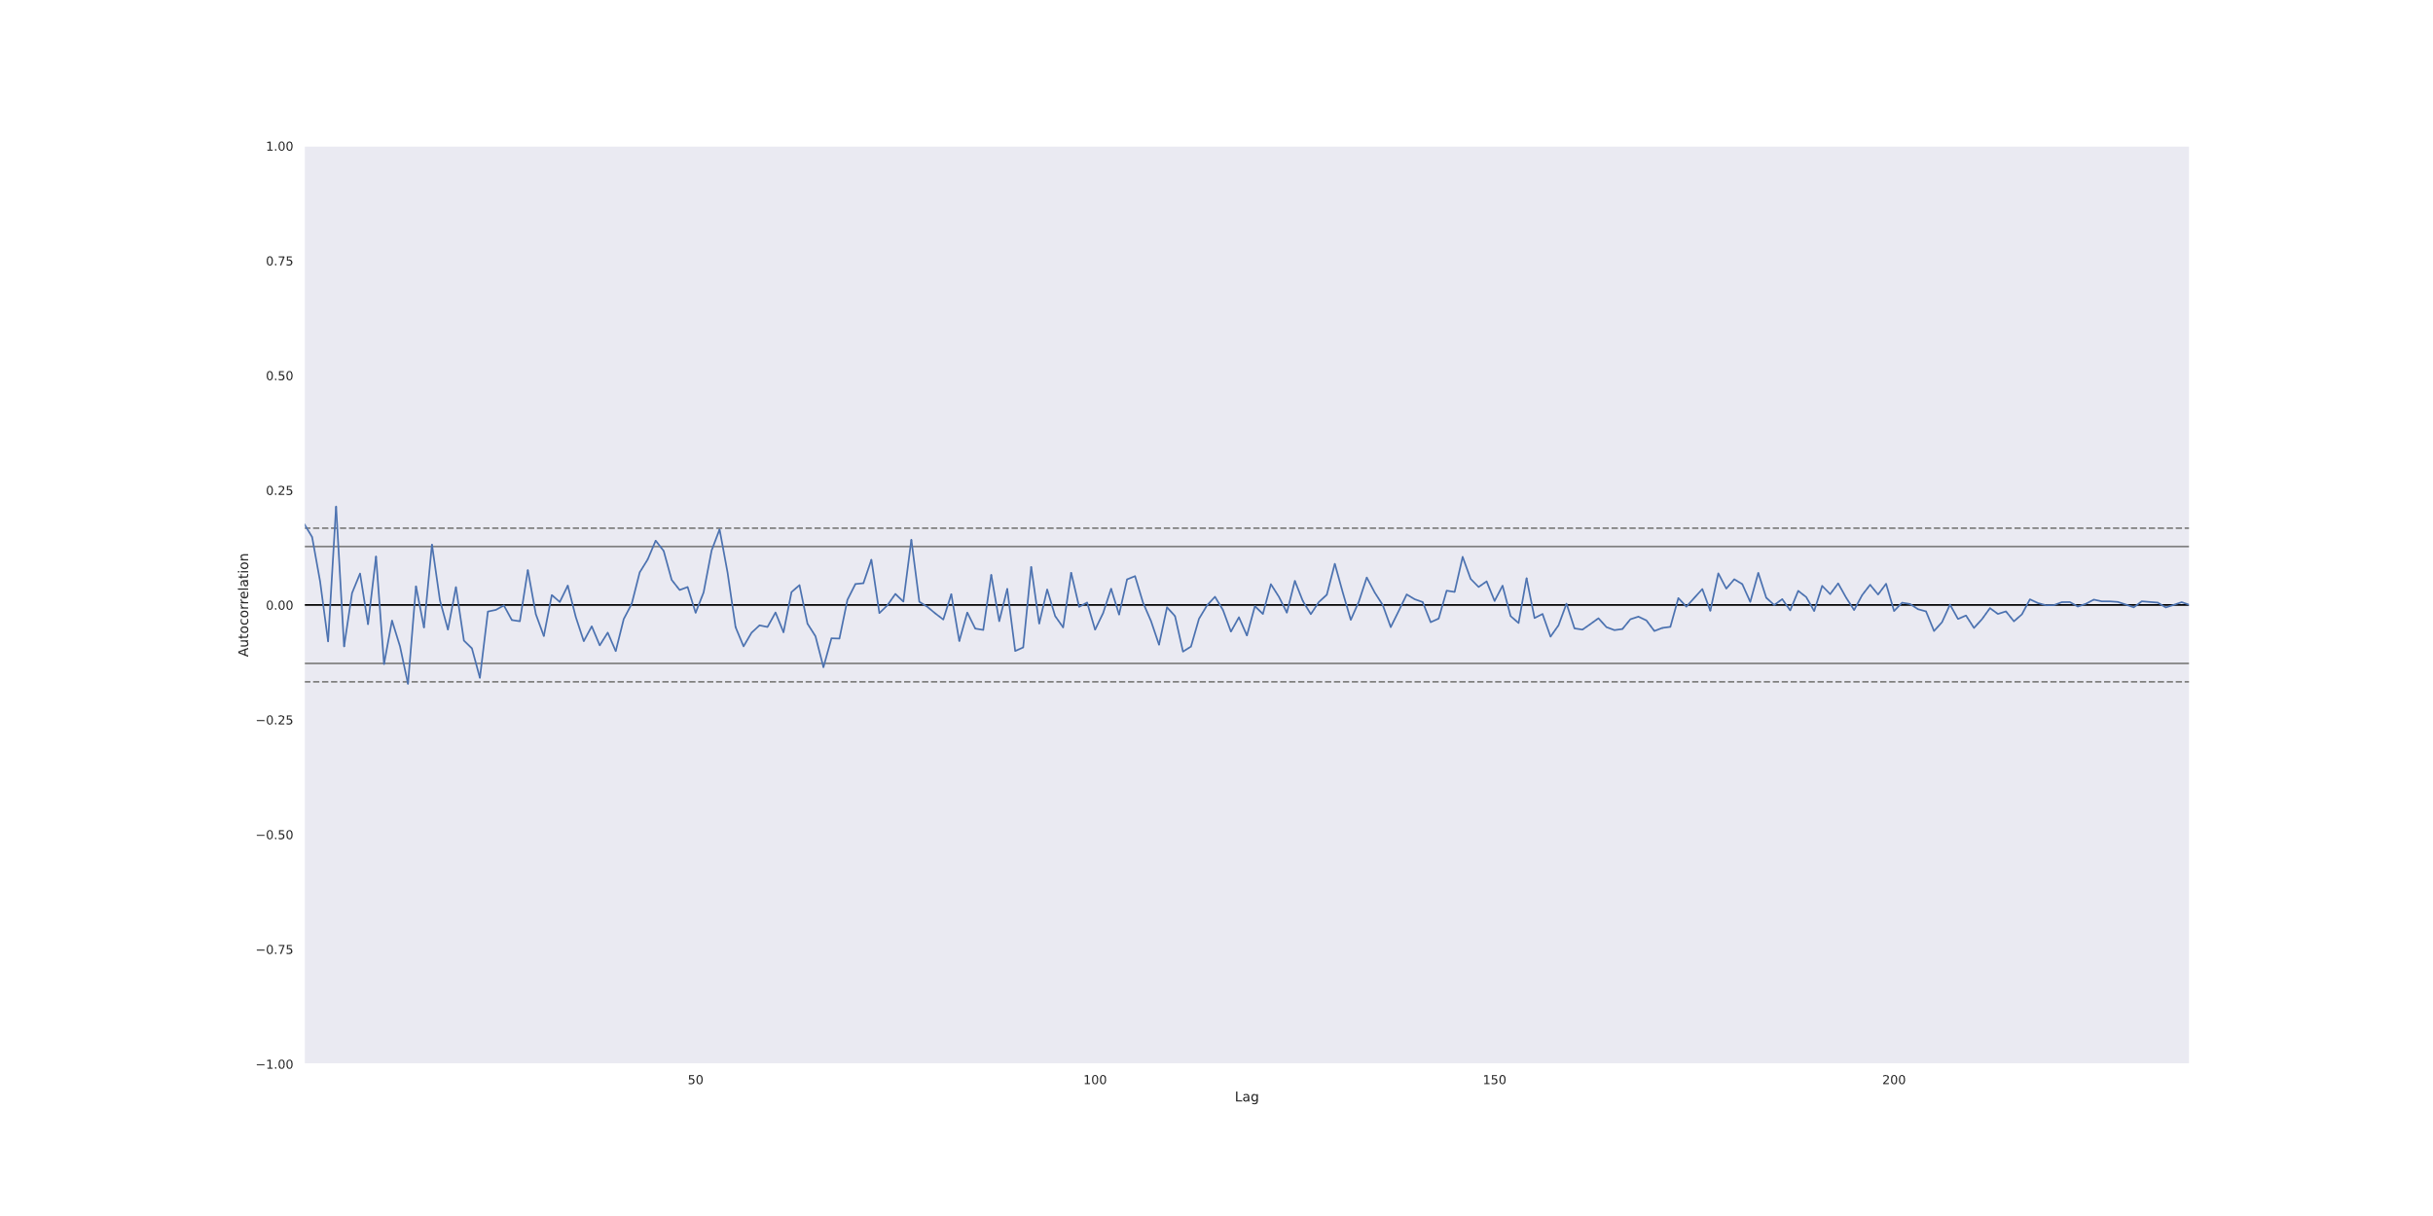
Autocorrelation & Partial

Slide 20
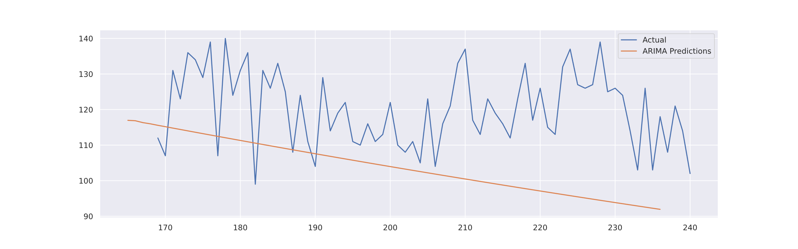
Sarimax fit and Seasonal decompose

Slide 21
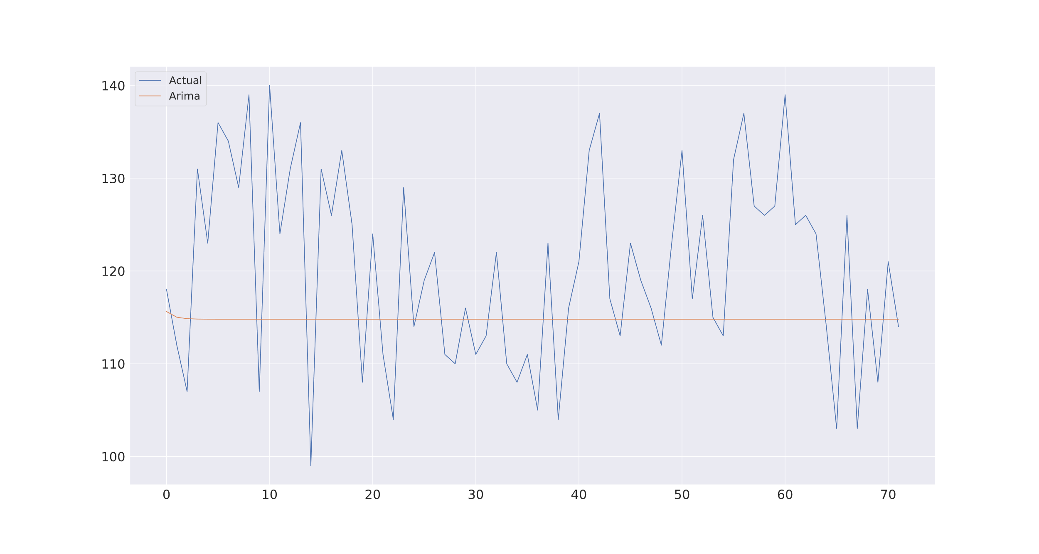
Arima

Slide 22
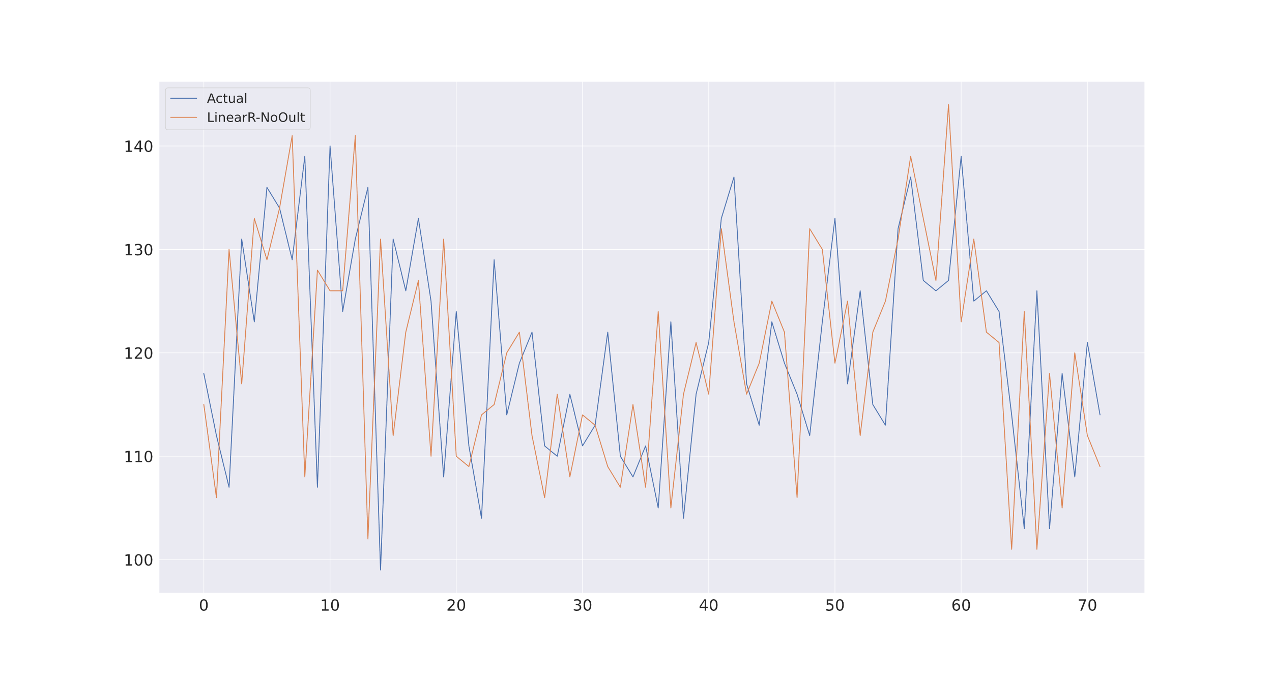
Linear Regression without Outliers

Slide 23
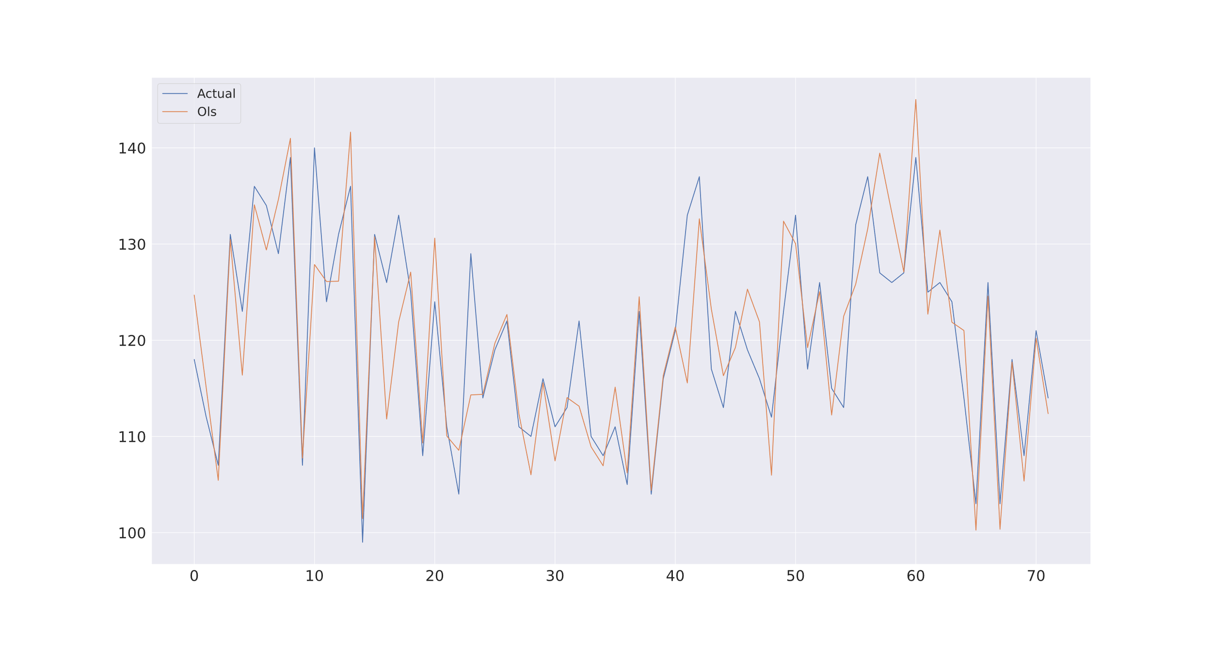
Least Square REgression

Slide 24
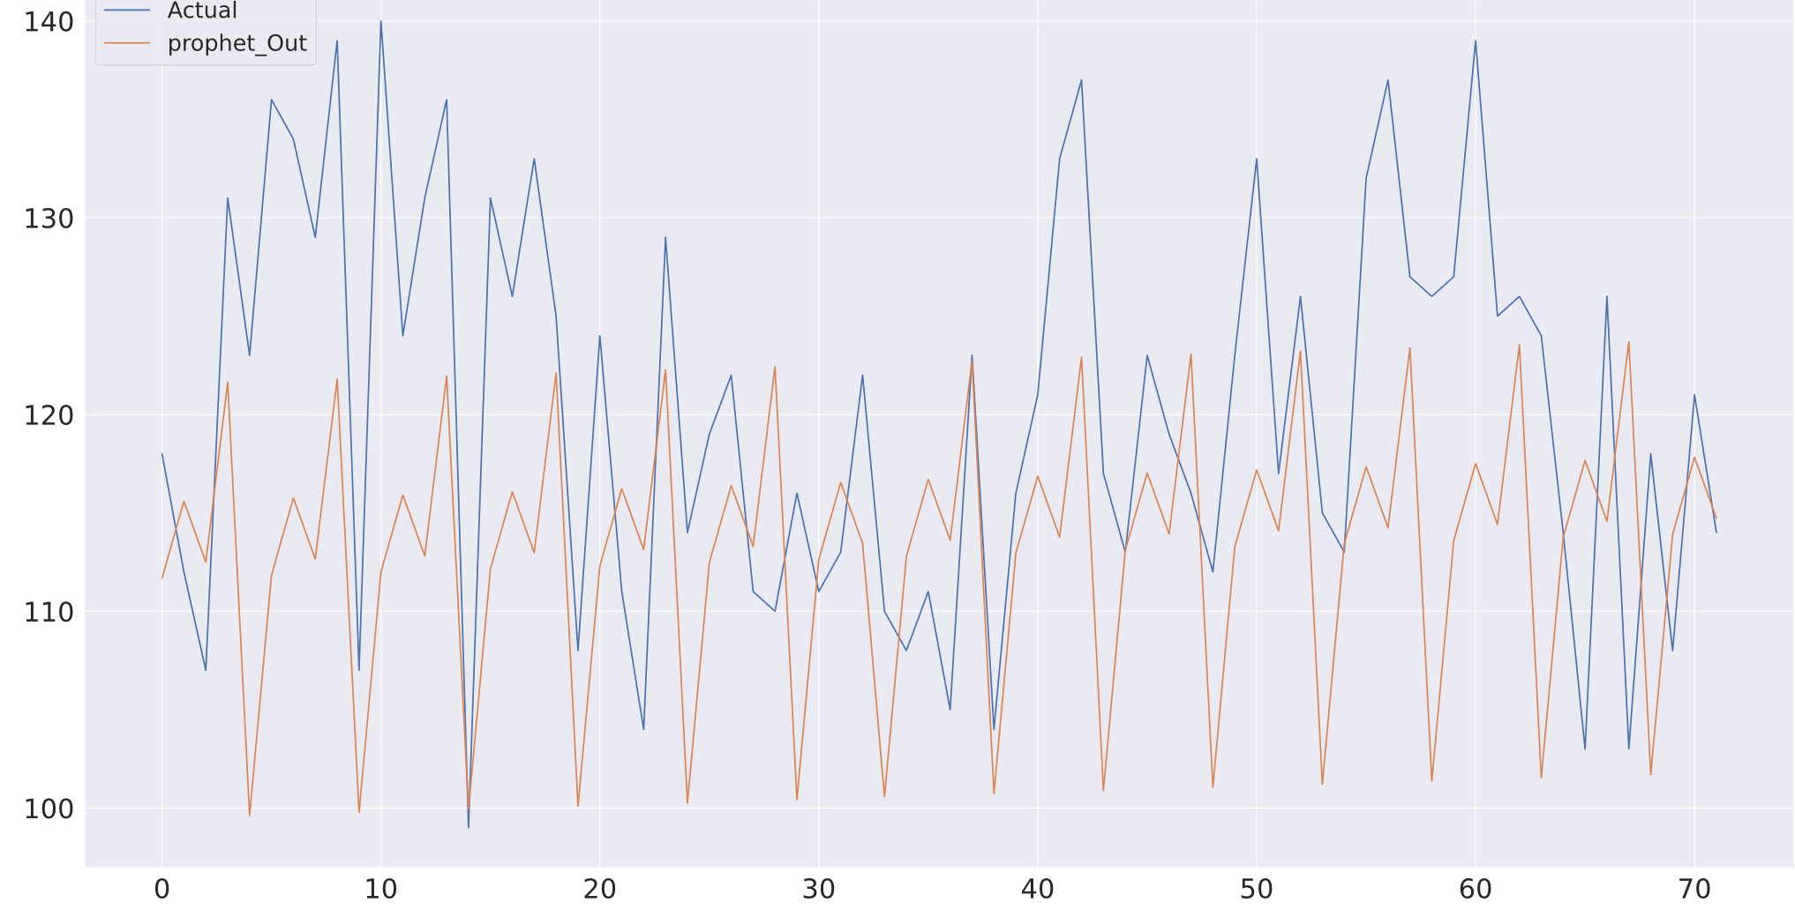
Prophet with outliers

Slide 25
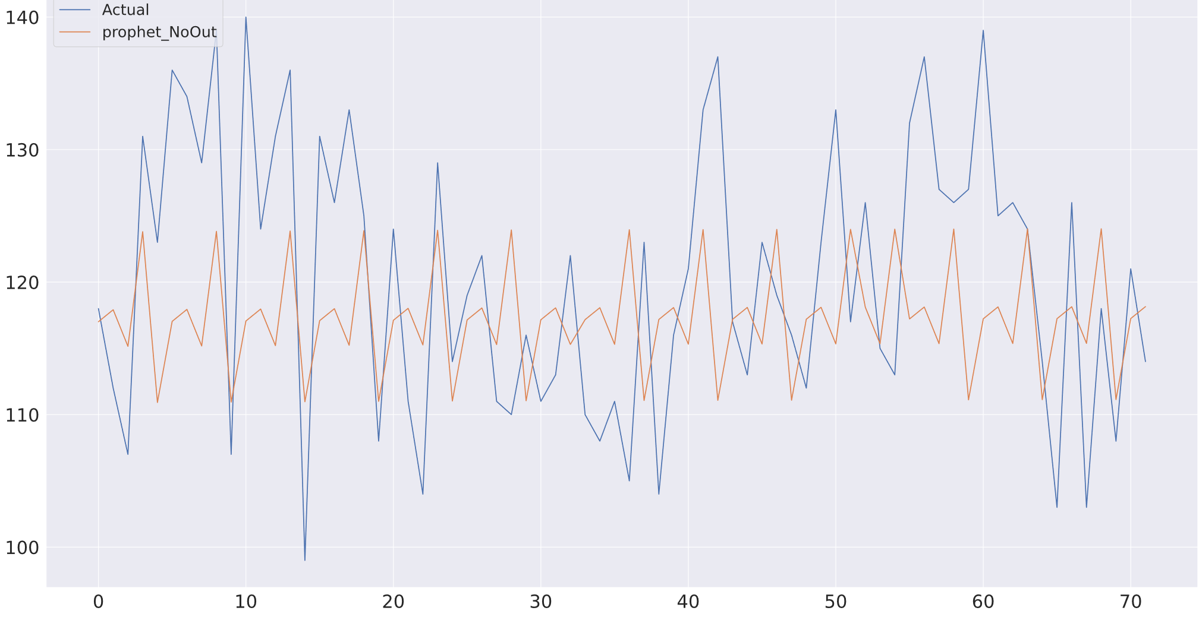
Prophet no outliers

Slide 26
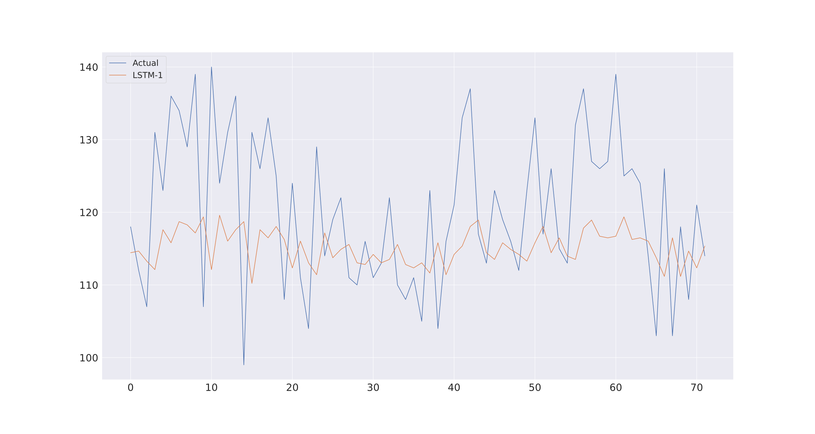
Lstm with actual data only

Slide 27
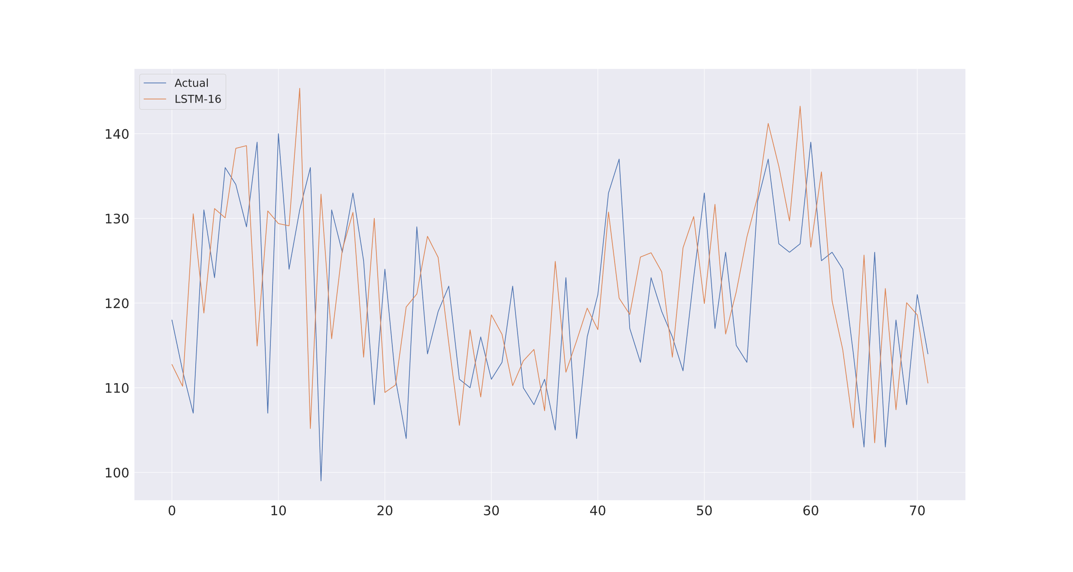
Lstm with all lookahead windows

